Slide 1
Zero Waste Systems
Amanda Rice Waddle
September 2, 2026

Slide 2
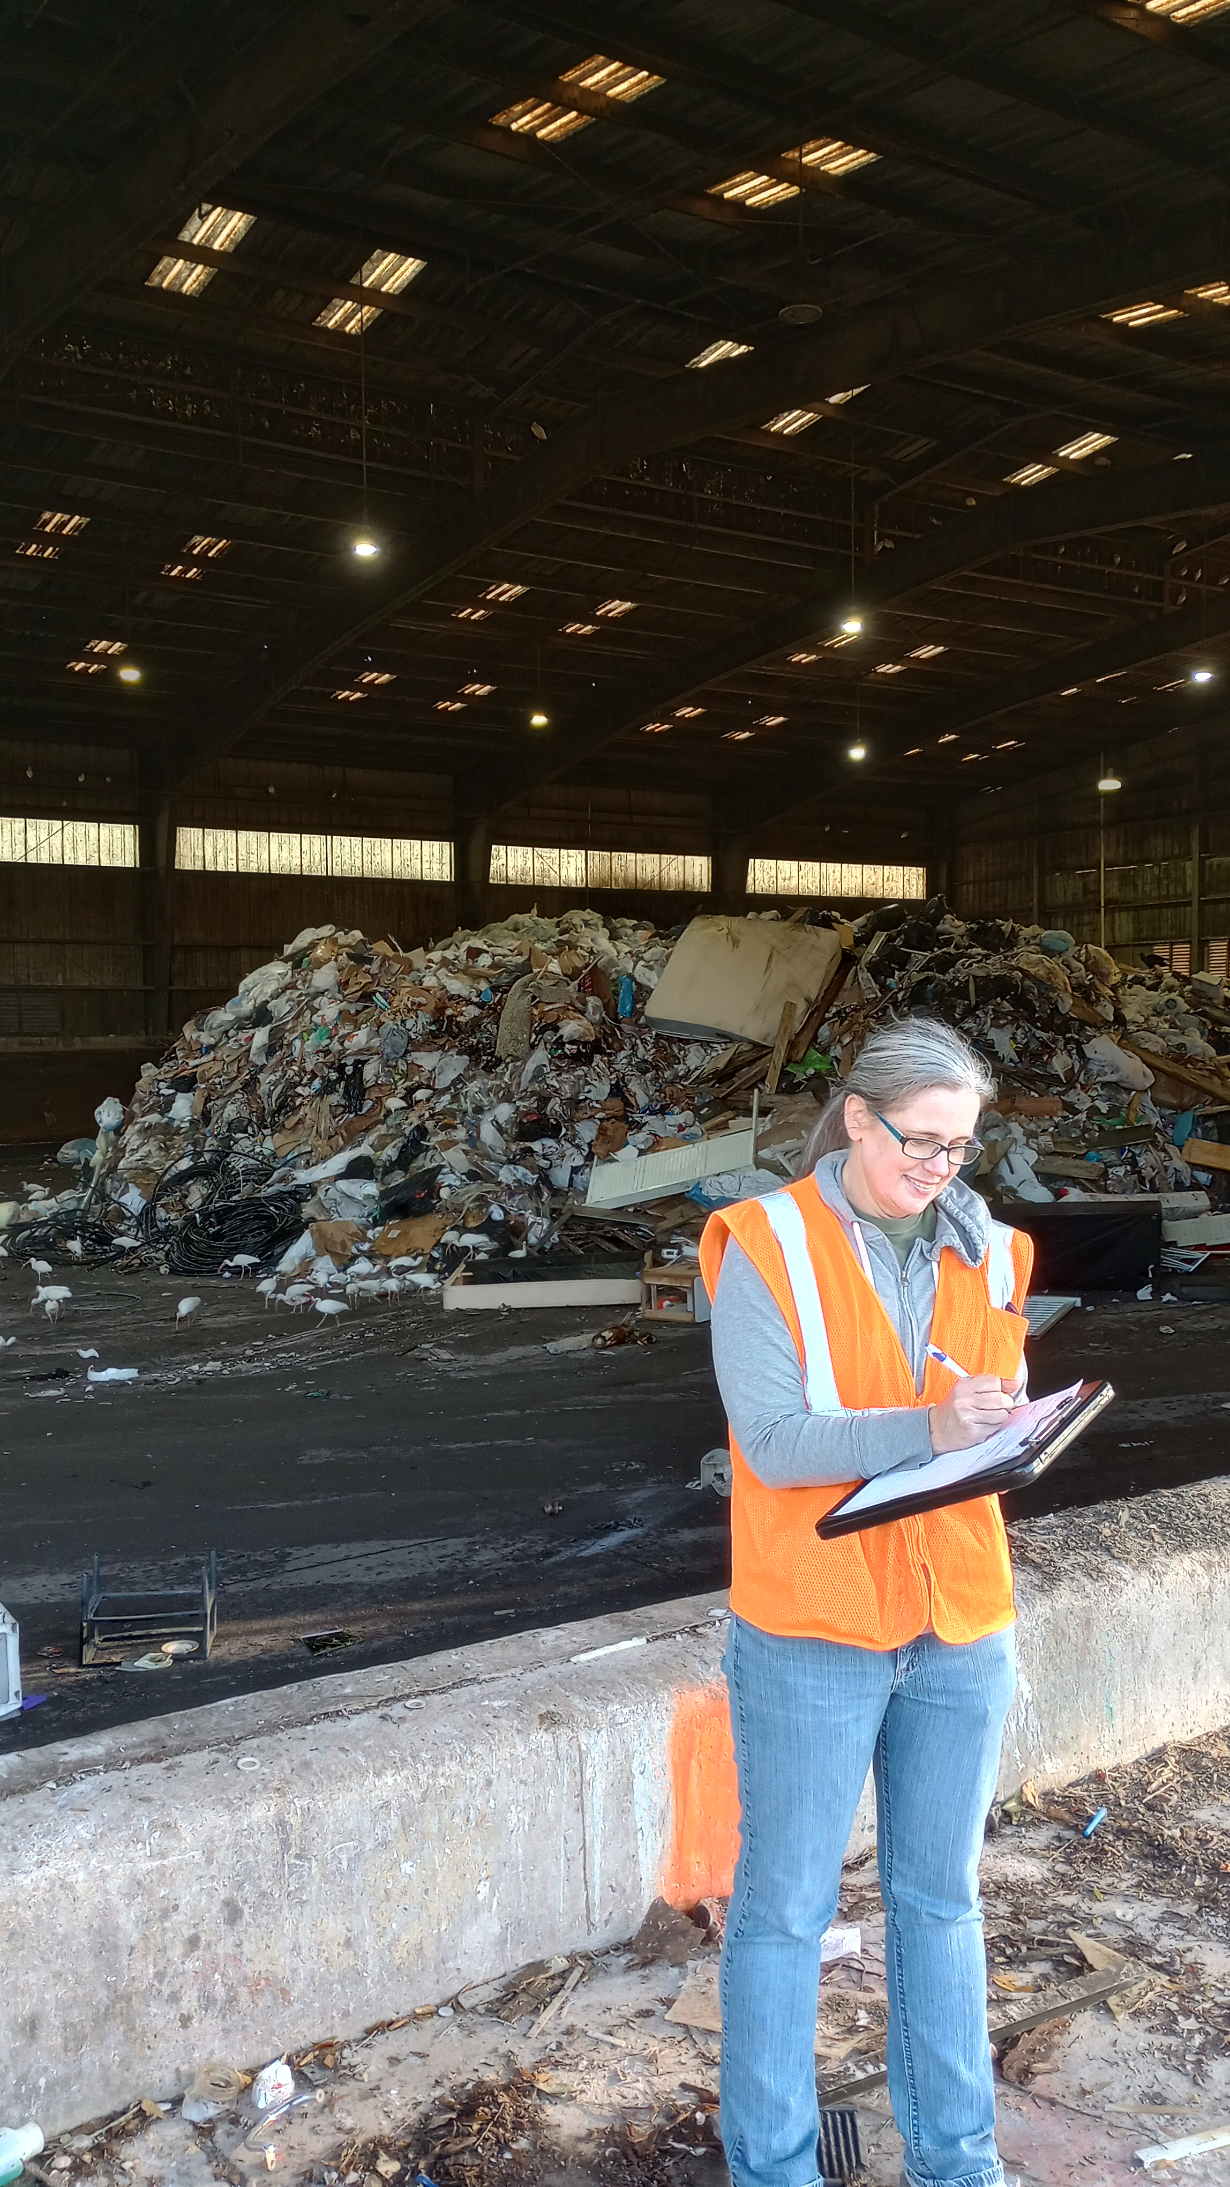
Amanda Rice Waddle
Director of Zero Waste
  The Repurpose Project
Director
  Zero Waste Gainesville
Program Manager
  Zero Waste USA
Zero Waste Consultant
  Zero Waste Associate
Zero Waste System Change

Slide 3
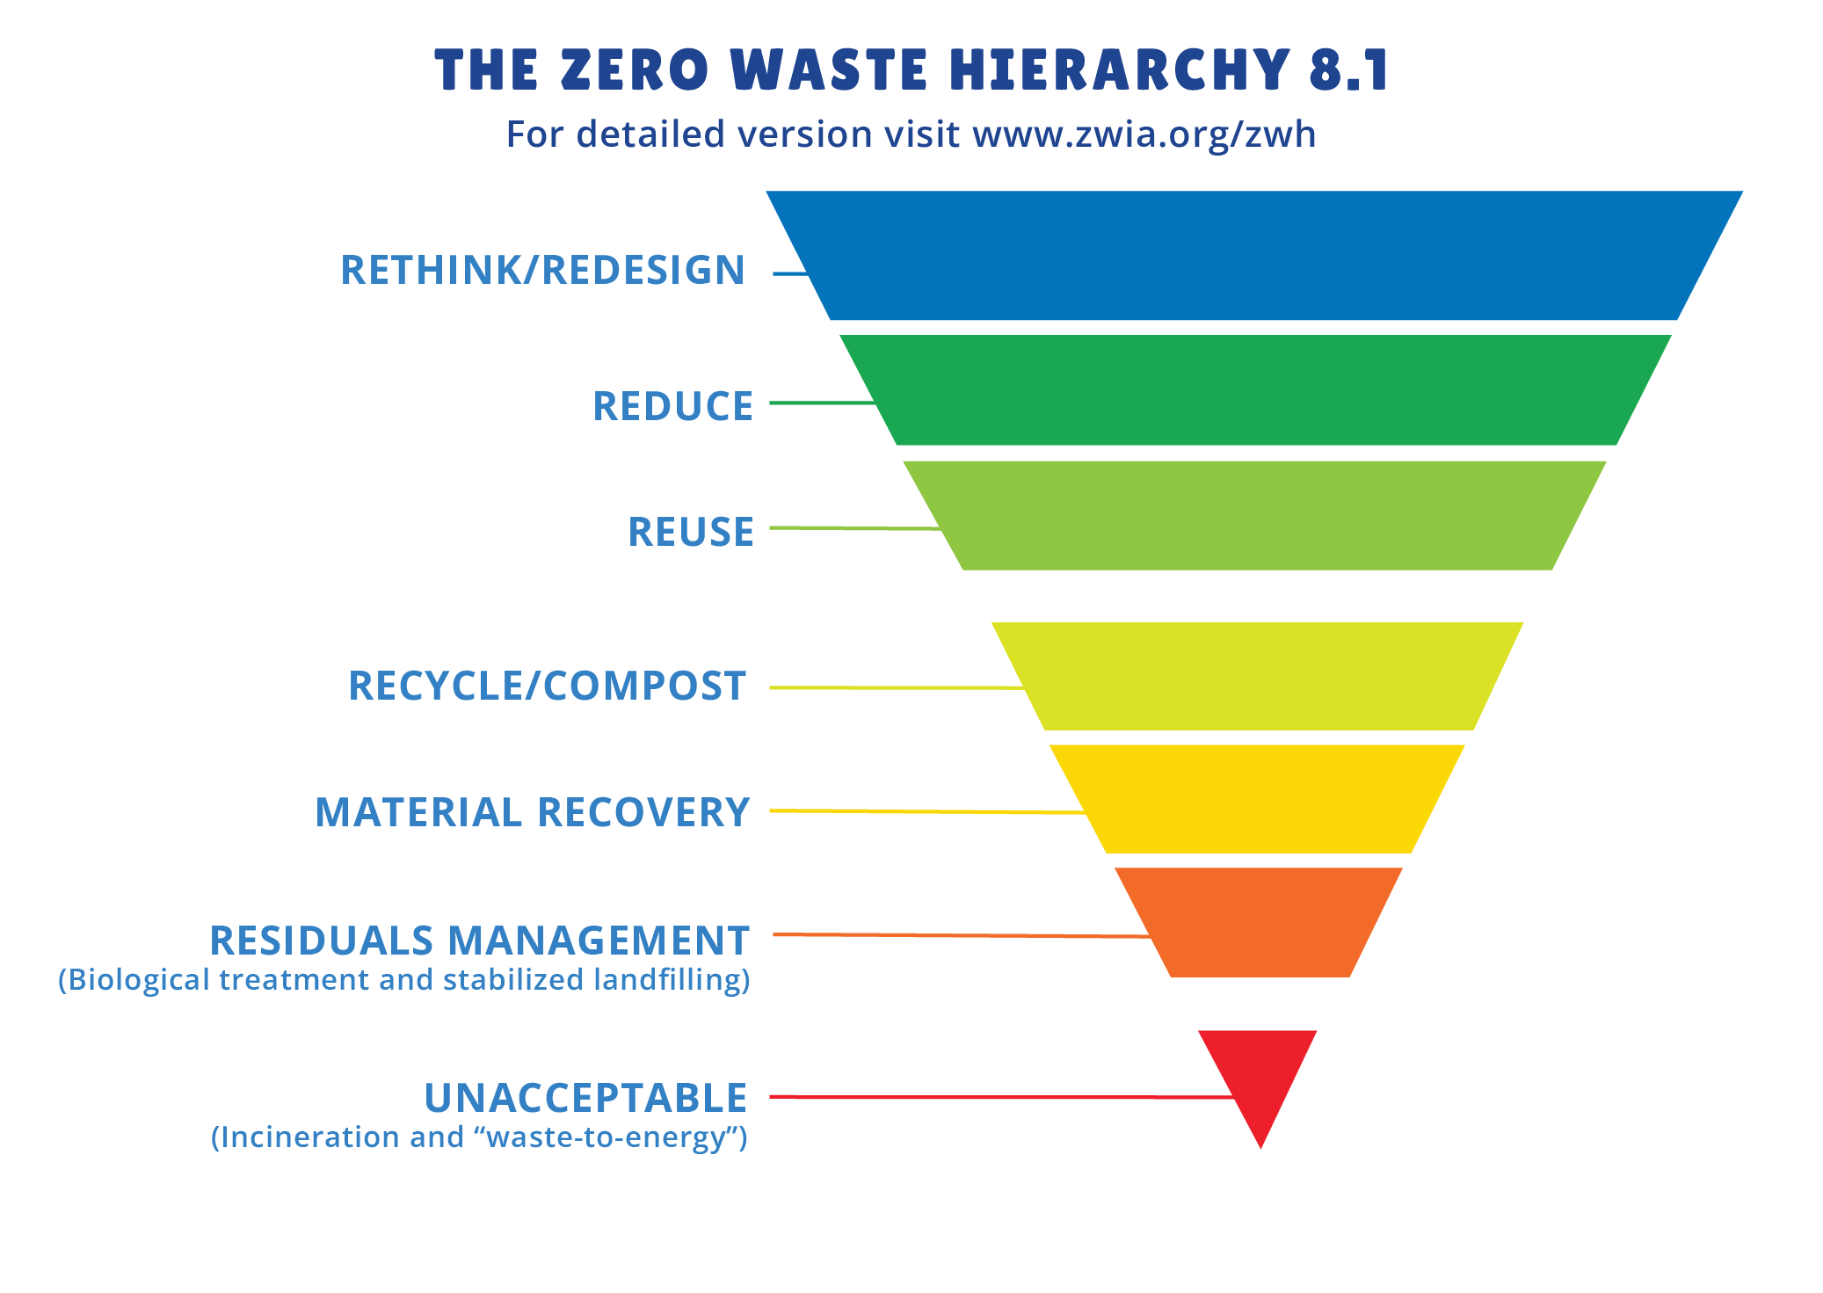

Two Zero Waste Principles
International Peer-Reviewed Definition of Zero Waste
Zero Waste: The conservation of all resources by means of responsible production, consumption, reuse, and recovery of products, packaging, and materials without burning and with no discharges to land, water, or air that threaten the environment or human health.
Source: Zero Waste International Alliance

Slide 4
What is Zero Waste?
90% Performance Measure
Materials not Waste
Value Resources
Visionary and Aspirational
“I don’t believe in Zero Waste”
“Zero Waste isn’t possible”
“I recycle everything”

Slide 5
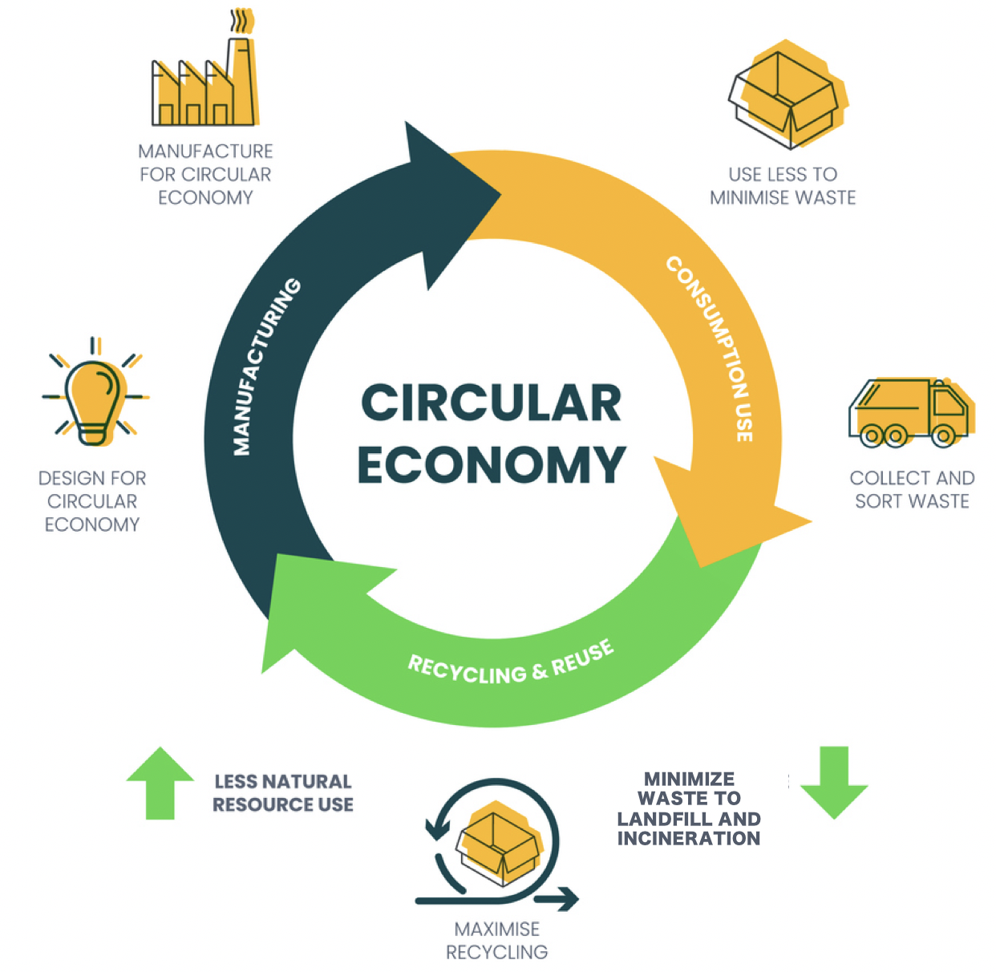

Slide 6
Source: Zero Waste International Alliance

Slide 7


Slide 8


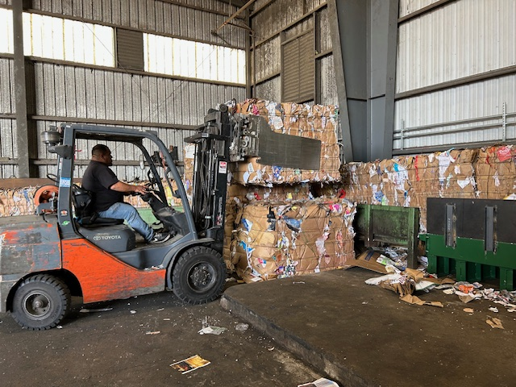
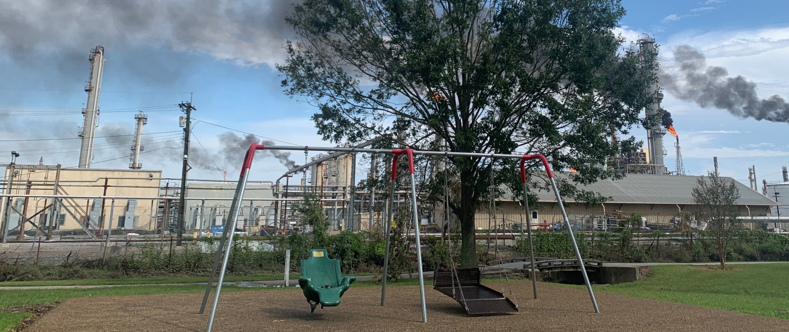
Why Create Zero Waste Systems?

Slide 9
How do we Create Zero Waste Systems?
Advocacy
NGO or Community Group
Someone must ask
Planning
Stakeholder Outreach – workshops, town halls, surveys, interviews
Zero Waste Initiatives (or strategies) – policies, programs, and infrastructure
Implementation
Puts the planning (Zero Waste Initiatives) into action
Must have community buy-in, support, and leadership from the top

Slide 10
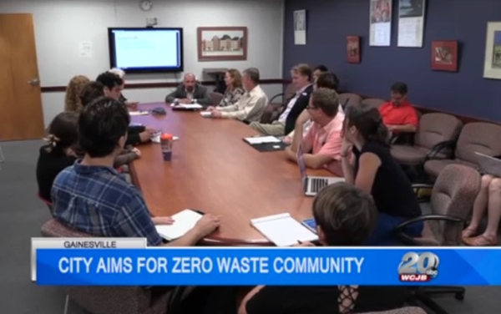
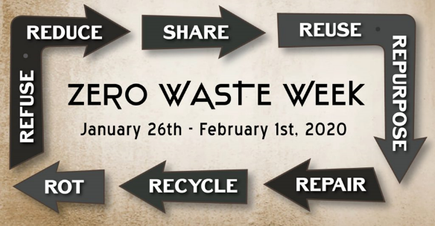
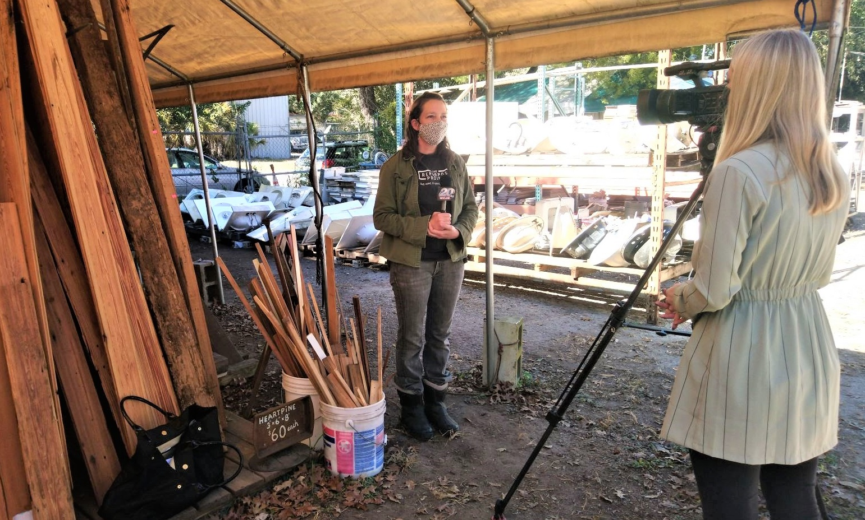
Zero Waste Advocacy
Ask for Zero Waste
Educate the Public
Work as Partners to Create Zero Waste
Source: Zero Waste Gainesville

Slide 11
Zero Waste Planning
Municipalities, Businesses, and Institutions need a plan to create Zero Waste systems
Community Participation
  Visioning workshop
  Planning charrettes
  Stakeholder engagement
Evaluate Current Policies, Programs, and Infrastructure
Conduct Service Analysis
Develop a Menu of Zero Waste Strategy Options
Conduct Economic Analysis & Diversion Potential and Greenhouse Gas Emissions Reduction Analysis
Develop the Zero Waste Strategic Plan
Source: Zero Waste USA Resources

Slide 12
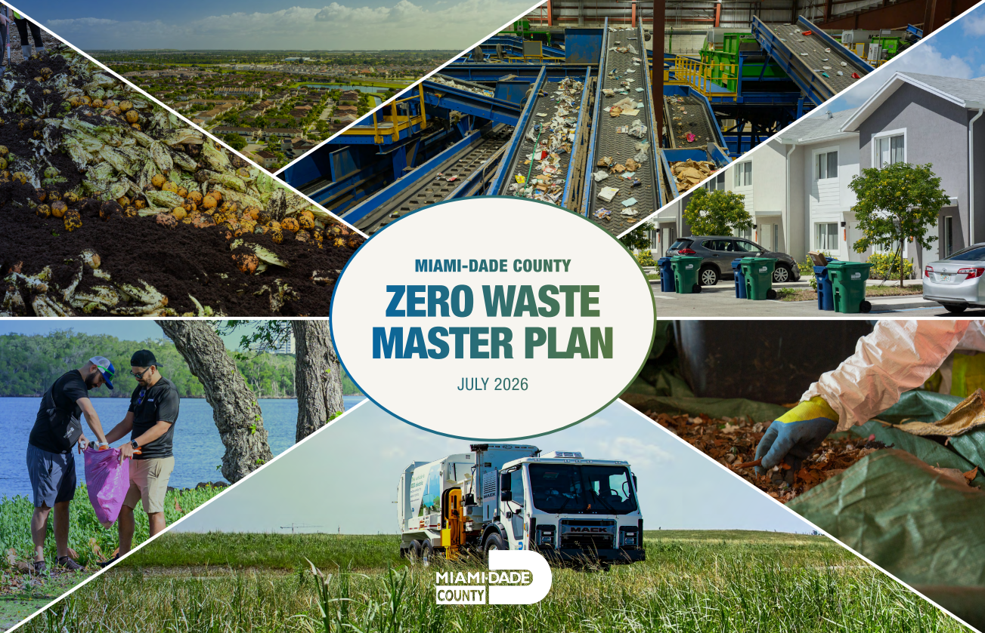
Zero Waste Planning
1.5 years
Implementation during planning
31 Zero Waste Strategies
Press Release
Find $1M for implementation
Quarterly Community Check-ins
Nick Ciancio + additional staff
Source: MDC Journey to Zero Waste

Slide 13
Zero Waste Implementation
The implementation goal is to create Zero Waste systems
Policies
Universal Services
Single-Use Material Bans
Programs
Education and Outreach
Technical Assistance
Infrastructure
Resource Recovery Park
Composting Operation

Slide 15
Zero Waste Barriers
Staff
Money
Time
Direction
Expertise
Incentives
Motivation

Slide 16
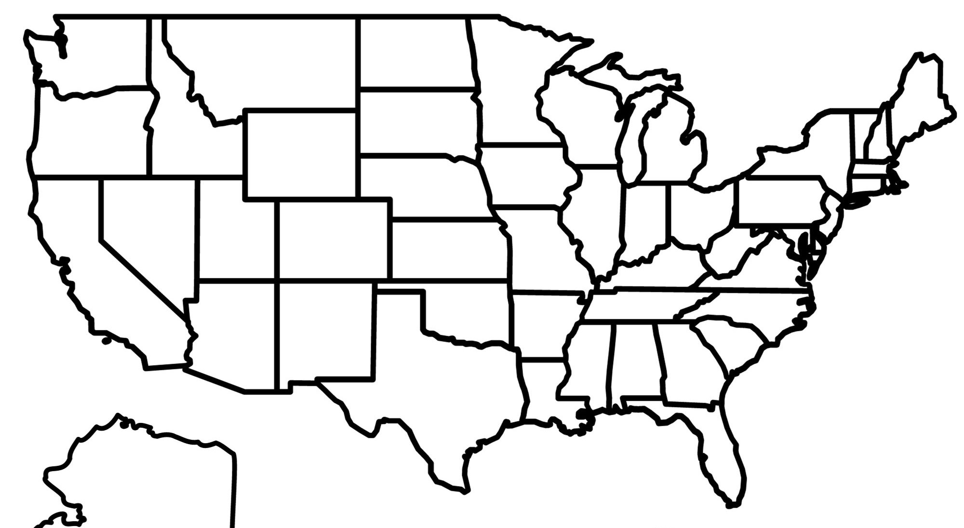
Zero Waste Case Studies
Worcester, MA
Washington, DC
San Francisco, CA
Gainesville, FL
Source: Mapping zero waste cities

Slide 17
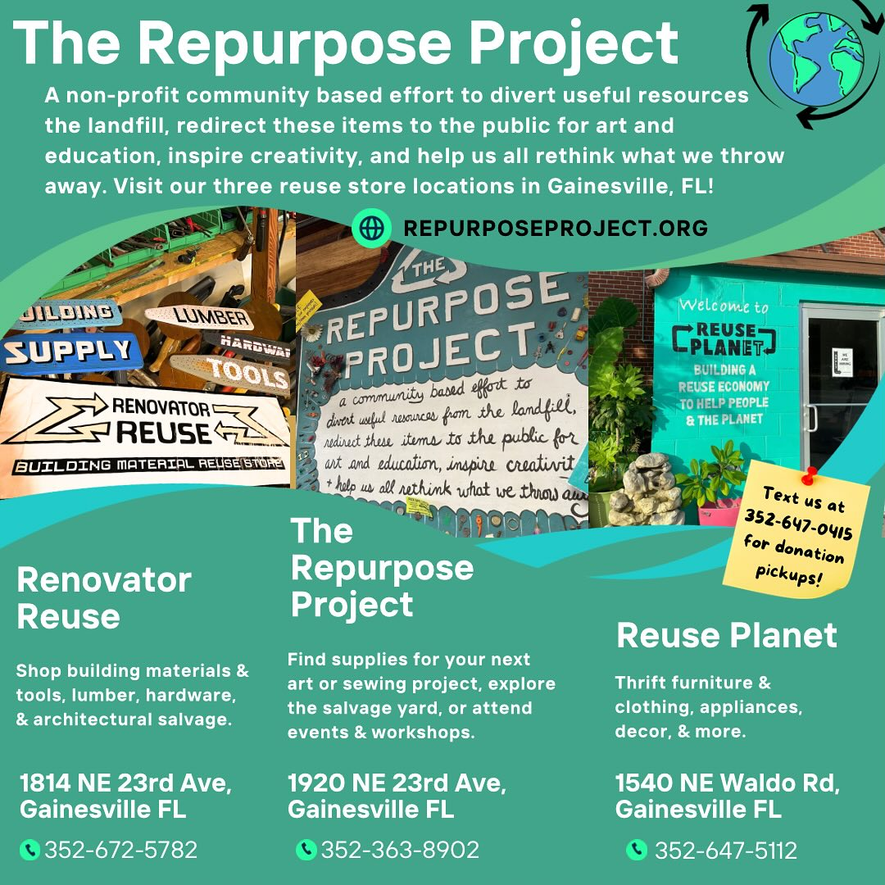
Gainesville, FL –
Focus Reuse
Source: The Repurpose Project

Slide 18
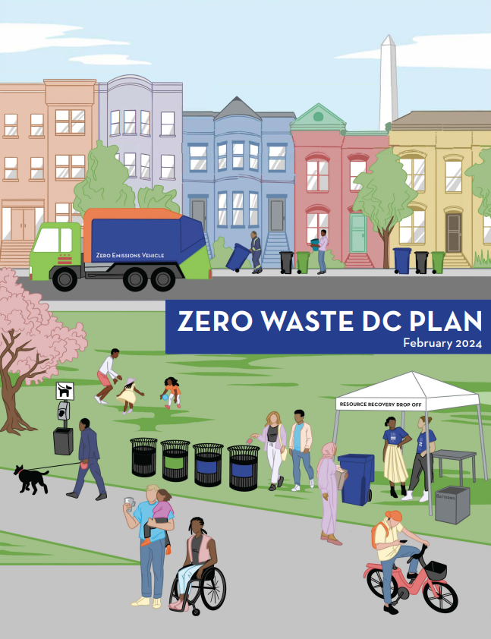
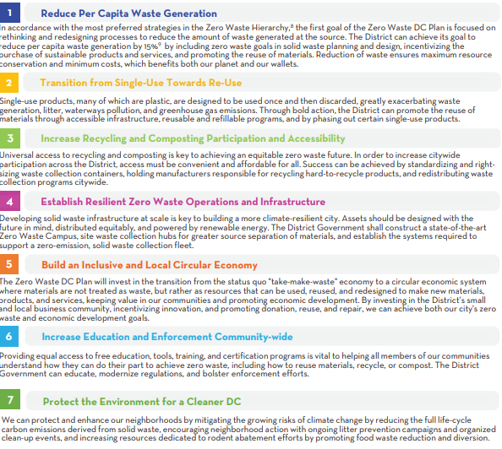
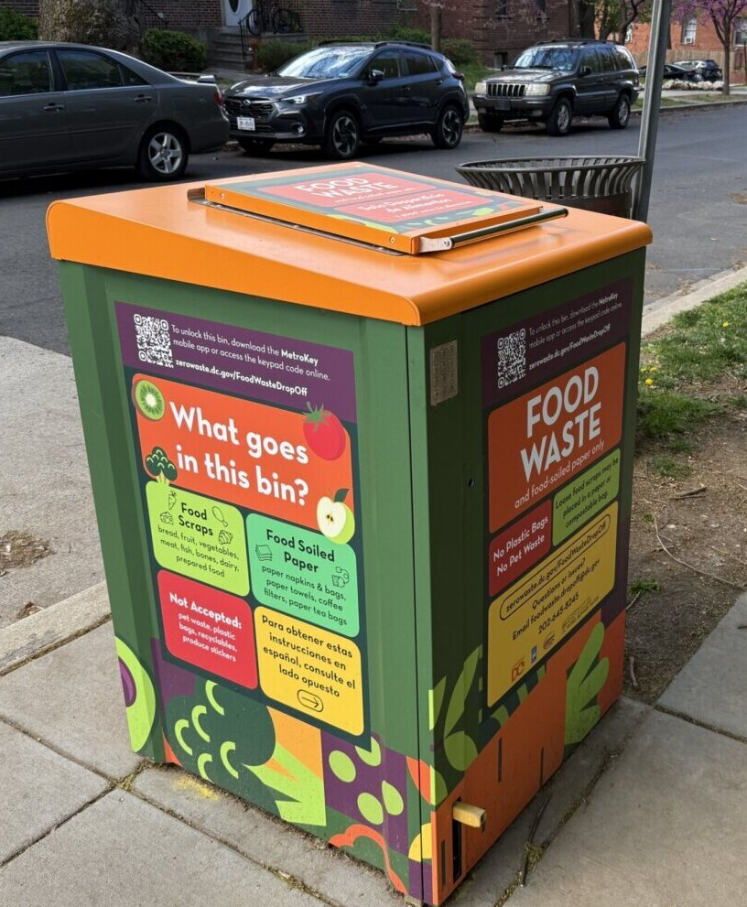
Washington, DC
Focus - Single-use Materials & Food
Source: Zero Waste DC Plan

Slide 19
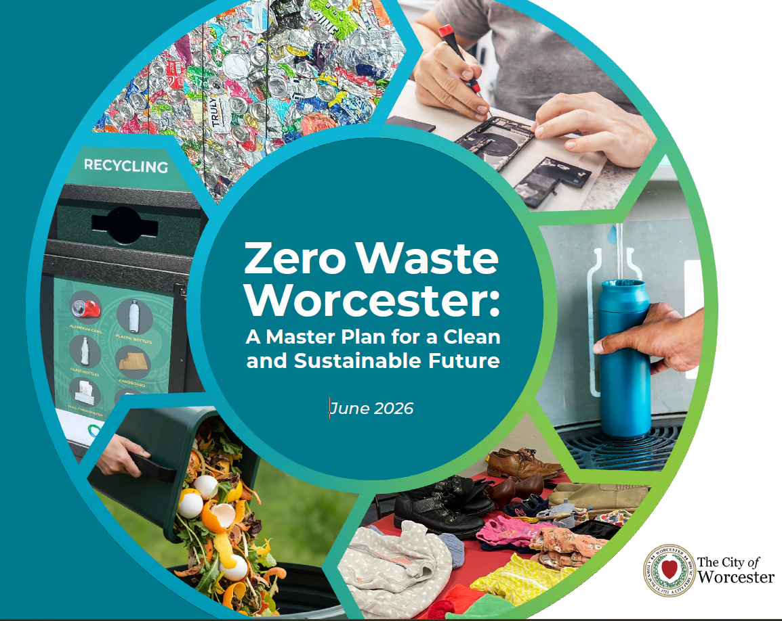
Worcester, MA
State Mandates
Source: City of Worcester, Zero Waste Program

Slide 20
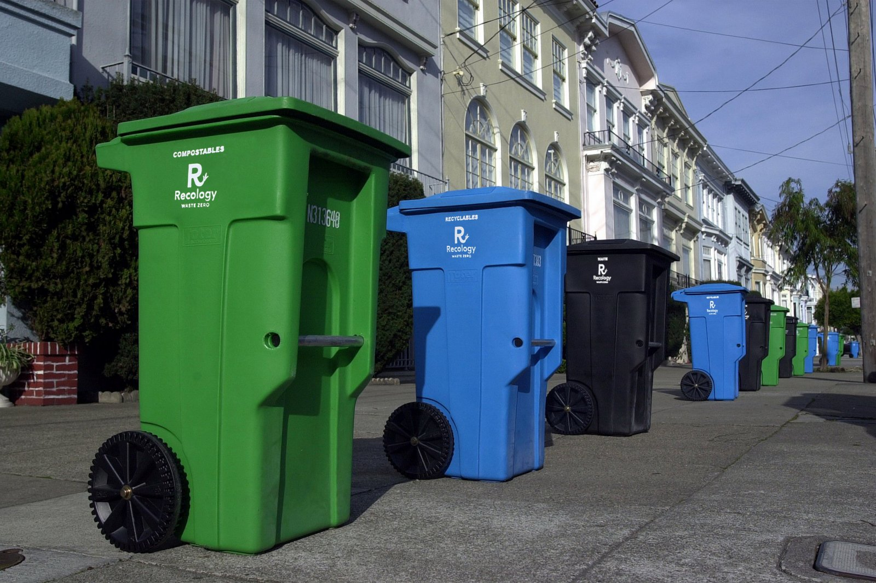
San Francisco
Three Bin System
Source: San Francisco Environmental Department: Zero Waste

Slide 21
What’s Next and Who’s In?
Municipalities – resolution, goal, plan, stakeholder outreach
Businesses – leadership, plan, Zero Waste audit, Zero Waste purchasing
Institutions – K-12 and higher – leadership, Zero Waste purchasing, teamwork, staff, plan

Slide 22

Thank you!
amanda@zerowasteusa.org

