Slide 1

Up, Down & Sideways
Recycling Markets 2026
Chaz Miller
Sept 2, 2026
Notes:
CURRENT NATIONAL & SOUTH CENTRAL PRICES
WHAT IS DRIVING RECYCLING MARKETS
& PREDICT WHERE THEY MIGHT BE GOING
I HAVE ABOUT 18 SLIDES IN MY PRESENTATION
AND ABOUT A DOZEN DETAILED SLIDES IN THE APPENDIX
I DON’T WANT ANYONE TO DIE FROM DEATH BY POWER POINT
YOU DON’T NEED TO TAKE NOTES
A COPY OF MY SLIDES WILL BE AVAILABLE FROM OKRA & MYSELF
BUT FIRST, WHAT ARE RECYCLABLES?

Slide 2
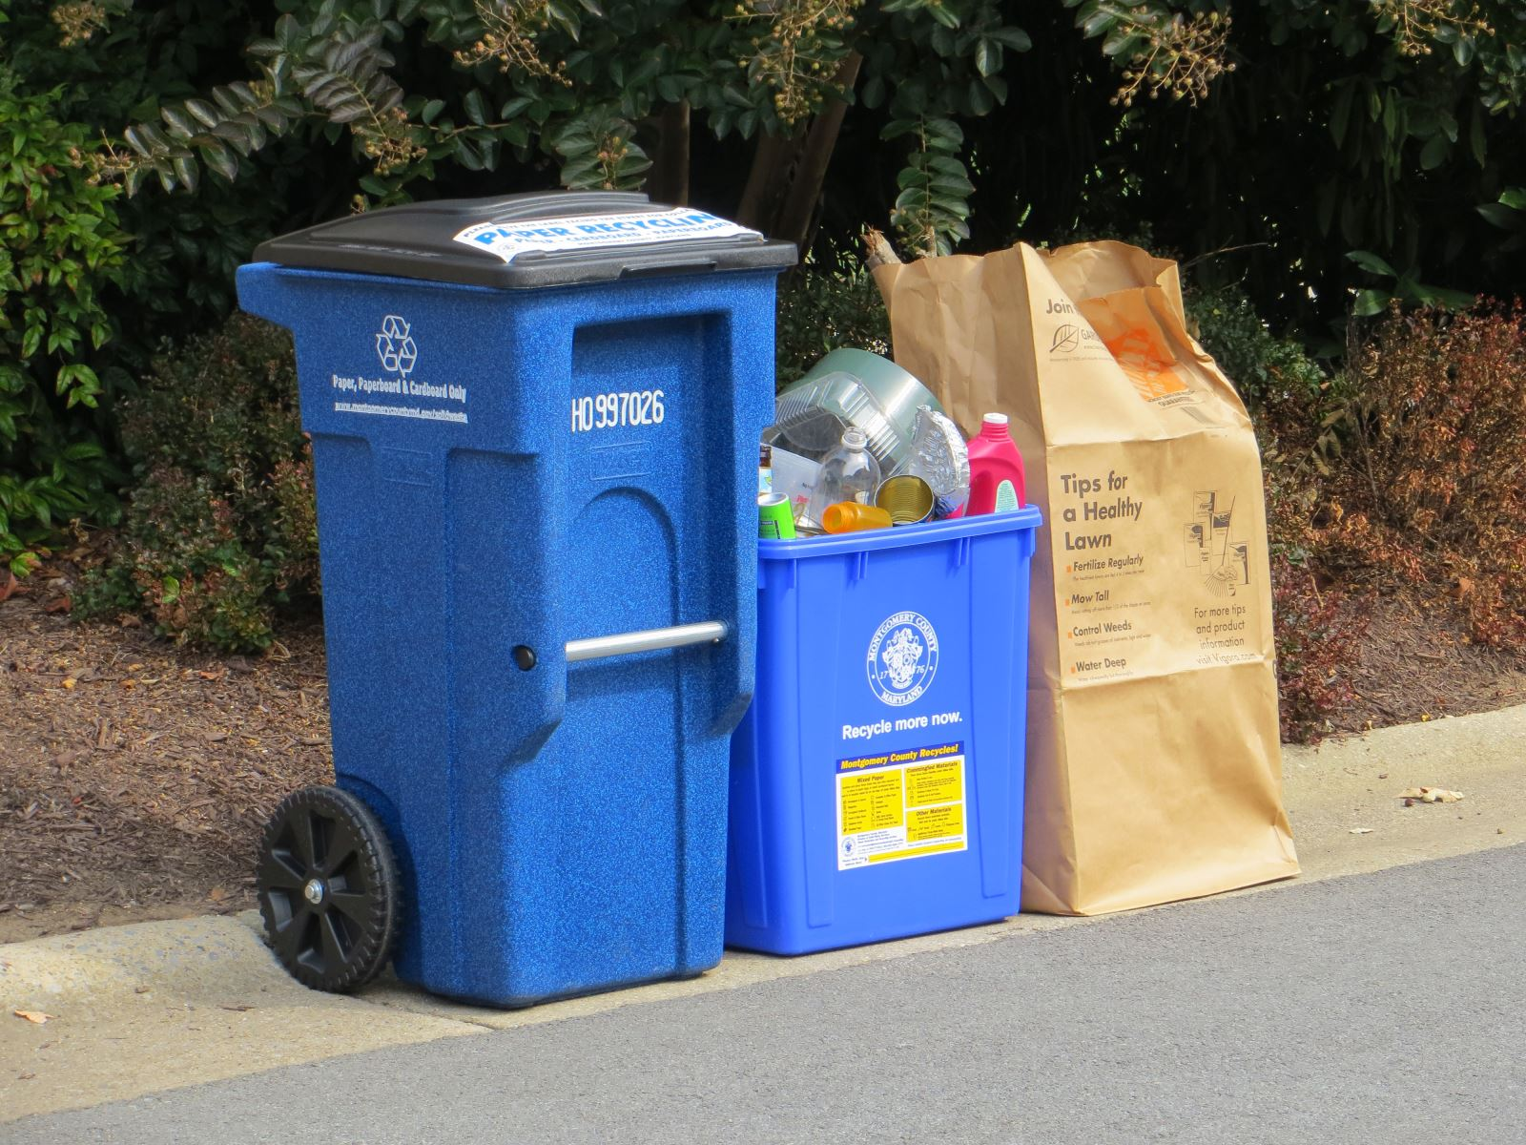
What Are These &
Where Do They Go?
Notes:
MONTGOMERY COUNTY DEP
RECYCLABLES ARE SIMPLY RAW MATERIALS LOOKING FOR BUYERS
BECAUSE RECYCLABLES ARE BOUGHT NOT SOLD

Slide 3
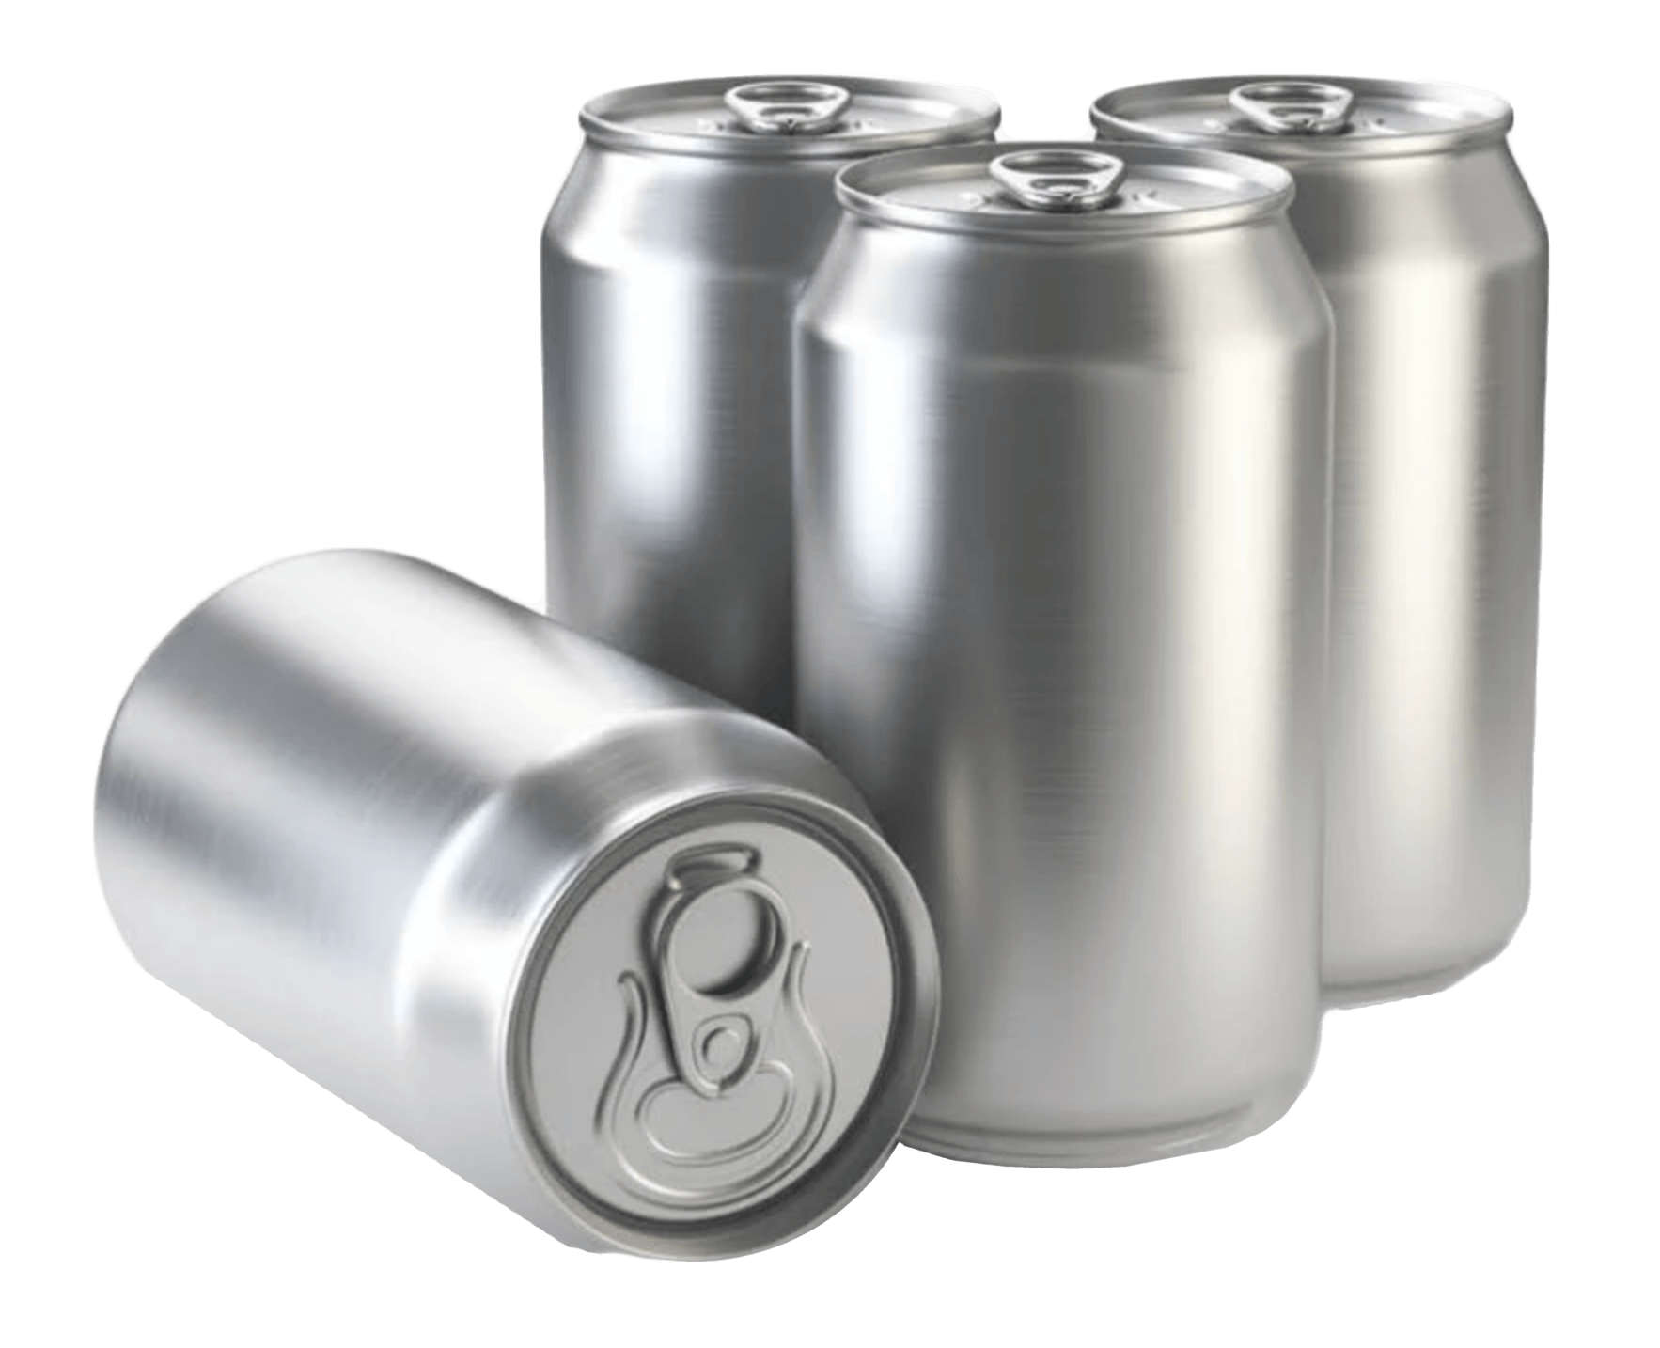



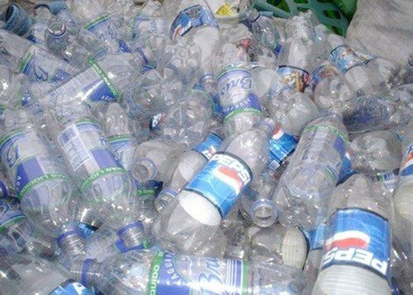
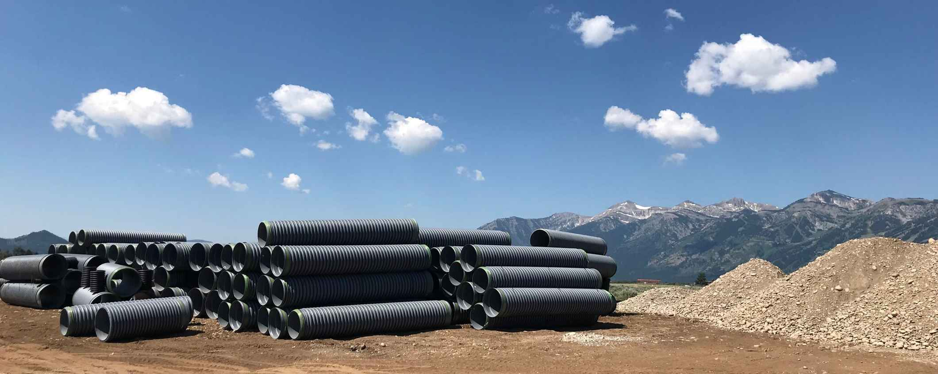


Products
Notes:
ALL AMERICAN 930 ALUMINUM – FOUNDRY STEEL FABRICATION SERVICES – WASTE360 & WASTE360
GREENMAX INTCO RECYCLING – ADS – FLOORSWOME – SPEEDQUEEN
A WIDE ARRAY OF PRODUCTS
CANS – BRIDGES – BOTTLES – BOXES – BOTTLES – PIPE – CARPET – BOTTLES
BUYERS WANT
CONSISTENT QUALITY
CONSISTENT QUANITY
AT AN ACCEPTABLE PRICE
LOOKING FOR THAT SWEET SPOT WHERE BUYERS & SELLERS ARE HAPPY & NO ONE IS STEALING THE RECYCLABLES
NOTE: RECYCLABLES CAN BE CIRCULAR BUT MANY MARKETS AREN’T AS THE SLIDES POINT OUT
LOCAL GOVERNMENTS & MRFS ARE MORE INTERESTED IN REVENUE THAN MEETING CIRCULARITY CRITERIA

Slide 4
Key Points End of August
2 up 4 down, 2 flat
OCC & RMP up
nHDPE, cHDPE, PET and steel cans down
PP and aluminum cans flat
Retail economy weak:
unit sales blah
housing slump continues
K-shaped economy
Notes:
2 UP, 4, DOWN, 2 FLAT
PAPER UP
BENEFITTING FROM BETTER DEMAND-SUPPLY BALANCE
OCC PRICE SOLID, RMP ON THE LOW SIDE OF GOOD
ALUMINUM FLAT & STEEL DOWN SLIGHTLY
BOTH PRICES SOLID
IRAN WAR & TARIFFS COMPLICATE BOTH
NHPDE CHDPE & PP DOWN, PET FLAT
NDHPE, CHDPE & PP PRICES SOFT
PET REMAINS ABYSMALLY LOW
RETAIL ECONOMY AS A WHOLE REMAINS WEAK
LESS NEED FOR PACKAGES & OTHER RECYCLED CONTENT PRODUCTS
SOUTH CENTRAL:
OCC, NHDPE, CHDPE, PP & PET ABOVE NATIONAL AVERAGE
RMP, AL & STEEL CANS BELOW

Slide 5
OCC National
January 2020 – August 2026
Notes:
DATA: RECYCLING MARKETS.NET
OLD CORRUGATED CONTAINERS (OCC) (BALED)
NATIONAL $80.31 PER TON
UP $3.43 FROM PREVIOUS MONTH ($76.88)
UP $12.81 YOY ($67.50)
DOWN $91.25 FROM SEPTEMBER 2021 HIGH ($171.56)
UP $55.62 FROM 2020 LOW ($24.69)
UP $58.12 FROM 2008 PRE COVID LOW ($22.19)
SOUTH CENTRAL $82.50 PER TON
MARKETS PRIMARILY LINERBOARD OR CORRUGATED MEDIUM
RAW MATERIALS FOR BOXES
BOX PRODUCTION DOWN OVER LAST FIVE YEARS

Slide 6
RMP National
January 2020 – August 2026
Notes:
RECYCLING MARKETS.NET
RESIDENTIAL MIXED PAPER - JUST ABOUT ALL PAPER EXCEPT TISSUE GRADES
NATIONAL AVERAGE $32.81 PER TON
UP $3.75 FROM LAST MONTH ($29.06)
UP 62 CENTS YOY ($32.19)
DOWN $64.07 FROM SEPTEMBER-NOVEMBER 2021 HIGH ($96.88)
UP $36.56 OVER 2020 LOW (-$4.38)
SOUTH CENTRAL $32.50 PER TON
MARKETS CAN BE SAME AS OCC BUT MORE LIKELY FOR LOWER GRADE PACKAGING OR PRODUCTS
MANY MILLS USE RMP AS AN OPTIONAL RAW MATERIAL
GENERALLY RISES & FALLS AT A DISCOUNT TO OCC
CURRENT SPREAD IS $47.50 PERF TON OR 59%

Slide 7
Natural HDPE National
January 2020 – August 2026
Notes:
DATA: RECYCLING MARKETS.NET
NATURAL HIGH DENSITY POLYETHYLENE (NHDPE)
NATIONAL 37.31 CENTS PER POUND
DOWN 4.57 CENTS FROM PREVIOUS MONTH (41.88 CENTS)
DOWN 10.25 CENTS YOY (47.56 CENTS)
DOWN 71.13 CENTS FROM AUG 21 HIGH (108.44 CENTS)
UP 14.93 CENTS FROM POST COVID LOW (22.38 CENTS)
UP 25.61 CENTS FROM 2008 LOW (11.69 CENTS)
SOUTH CENTRAL 38 CENTS PER POUND
MARKETS: CHDPE PACKAGING
HIGHLY VERSATILE B/C NOT DYED
MILK CONSUMPTION FLAT FOR A DECADE BUT ROSE BY 3.2% IN 2024
BRAND DEMAND DRIVE DROVE 2021 & 25 HIGHS
ARE WE GOING THROUGH ANOTHER CYCLE IN WHICH BRAND DEMAND DECLINES WHEN RECYCLED CONTENT GOALS MET & PRICES TOO HIGH?
VIRGIN PE PRICES SHOT UP IN MARCH & APRIL, THEN FELL IN JUNE & JULY
HIGHER VIRGIN PRICES HELPED RC SELLERS, LOWER PRICES HURT

Slide 8
CHDPE National
January 2020 – August 2026
Notes:
DATA: RECYCLING MARKETS.NET
COLORED HDPE
NATIONAL 6.44 CENTS PER POUND
DOWN 0.62 CENTS FROM LAST MONTH (7.06 CENTS)
UP 3.78 CENTS YOY (2.66 CENTS)
DOWN 51.69 CENTS FROM AUGUST 2021 HIGH (58.13 CENTS)
UP 2.91 CENTS FROM 2020 LOW (3.53 CENTS)
DOWN 0.12 CENTS FROM PRECOVID LOW (6.56)
SOUTH CENTRAL 7.5 CENTS PER POUND
MARKETS: PRIMARILY CONSTRUCTION USES: PIPES, ETC.
DYES CAN’T BE TAKEN OUT OF THE RECYCLED RESIN, LIMITING POTENTIAL MARKETS
SUPPLY: VERY WIDE ARRAY OF CONSUMER PROUCTS
STRONG CORRELATION B/W RCHDPE PRICE & NEW HOME PERMITS & STARTS
HOME CONSTRUCTION MARKET NOT IN GOOD SHAPE
HAS BENEFITTED FROM CONSTRUCTION OF AI DATA CENTERS

Slide 9
PP National
January 2020 –August 2026
Notes:
DATA: RECYCLING MARKETS.NET
POLYPROPYLENE (PP)
NATIONAL 6.5 CENTS PER POUND
SAME AS LAST MONTH
DOWN 38 CENTS FROM JULY 2021 HIGH (44.5 CENTS)
UP 3.5 CENTS OVER 2020 LOW (3 CENTS)
DOWN 0.13 CENTS FROM PRE-COVID LOW OF 6.63 CENTS
SOUTH CENTRAL 7.5 CENTS PER POUND
MARKETS: MOSTLY DURABLE PLASTICS FOR NON-CONSTRUCTION USES
STORAGE CONTAINERS, PAINT CANS, TOYS, BOTTLE CAPS, CAR BATTERY CASES, CARPET FIBER, PACKAGES, ETC.
MOSTLY NON-PACKAGING DURABLE PRODUCTS
SUPPLY A PROBLEM B/C PP PACKAGING IS A SMALL SHARE OF OVERALL PP USE
HIGHER VIRGIN PRICES IN MARCH & APRIL FUELED RECYCLED PRICE RISE
SUBSEQUENT PRICE DECLINE LIKELY CAUSED BY EXCESSIVE INVENTORIES IN ANTICIPATION OF HIGHER VIRGIN PRICES

Slide 10
PET National
January 2020 – August 2026
Notes:
DATA: RECYCLING MARKETS.NET
POLYETHYLENE TEREPHTHALATE (PET)
NATIONAL 2.63 CENTS PER POUND
DOWN 0.31 CENTS FROM LAST MONTH (2.94 CENTS)
DOWN 4.76 CENTS YOY (7.39 CENTS)
DOWN 38.1 CENTS FROM MAY 2022 RECORD (40.64 CENTS)
DOWN 3.54 CENTS FROM SEPT 2020 BOTTOM (6.17 CENTS)
DOWN 1.50 CENTS FROM PRE COVID LOW JAN 09 (4.13)
SOUTH CENTRAL 6 CENTS PER POUND (DOWN FROM 8 CENTS IN MID JULY)
MARKETS: PRIMARILY BOTTLES & FIBER
CHEAP VIRGIN & RECYCLED IMPORTS UNDERCUTTING DOMESTIC RPET PRICES
THREE RPET RECLAIMERS IN THE NORTHEAST HAVE CLOSED THIS YEAR
LAST TWO SUMMERS SAW SOFTENED BEVERAGE DEMAND
BEVERAGE COMPANIES NOT STEPPING UP RPET PURCHASES
FIBER INDUSTRY CUTTING BACK: E.G., CARPET MARKET SHARE OF FLOOR COVERINGS 66% IN 2007 48% IN 2024
https://www.fcnews.net/2023/06/carpet-stats-soft-surface-stagnates-in-2022/
VPET PRICES ROSE ABOUT 46 PERCENT IN MARCH & APRIL
DID NOT RISE IN MAY AND FELL IN THE SUMMER

Slide 11
Paper vs Plastic
Brown vs many colors
60% packaging vs 40%
Recycling since 1690 vs late 70’s

Slide 12
Aluminum Cans National
January 2020 – August 2026
Notes:
DATA: RECYCLING MARKETS.NET
NATIONAL 93.75 CENTS PER POUND
SAME AS LAST MONTH
UP 15.31 CENTS YOY (78.44 CENTS)
DOWN 30.06 CENTS FROM MAR 11 2022 HIGH (123.81 CENTS)
UP 54.62 CENTS FROM 2020 LOW (39.13 CENTS)
SOUTH CENTRAL 85 CENTS PER POUND
MARKETS: CANS
ALUMINUM PRODUCTS VERY ALLOY SPECIFIC
BEER SALES DROPPING AS CONSUMERS SWITCH TO OTHER BEVERAGES
NON-ALCOHOL BEVERAGE CAN SALES RISING
OTHER USE COULD BE CAST ALUMINUM BUT RARE IN NORTH AMERICA
STRAITS OF HORMUZ CLOSURES AFFECTS 20% OF WORLDWIDE ALUMINUM PRODUCTION
CHEAP ENERGY IN GULF STATES MAKES THEM MAJOR ALUMINUM SUPPLIERS
“MIDWEST PREMIUM” GOING UP: IT IS ADDED TO LONDON METALS EXCHANGE (LME) PRICES TO COVER TRANSPORTATION & TARIFFS RAISING VIRGIN ALUMINUM PRICE
ALL TIME ALUMINUM CAN HIGH PRICE SAME AS ALL TIME LME ALUMINUM PRICES

Slide 13
Steel Cans National
January 2020 – August 2026
Notes:
DATA: RECYCLING MARKETS.NET
STEEL CANS
$197.81 PER TON
DOWN $2.19 FROM LAST MONTH (200)
DOWN $39.68 FROM LAST YEAR ($158.13)
UP $107.19 FROM ALL TIME HIGH ($305)
UP $162.81 FROM ALL TIME LOW ($35 IN NOV-DEC 2015)
SOUTH CENTRAL $172.50
MARKETS: DETINNERS, ELECTRIC ARC FURNACES, FOUNDRIES
FOOD CANS ARE TINPLATED
TIN IS A CONTAMINANT IN STEEL PRODUCTION
DETINNING IS ABOUT 1% OF ALL US STEEL PRODUCTION
2018 TARIFFS LED TO CLOSURE OF ALL BUT 3 US FACILITIES
CLOSED TIN MILL BEING REOPENED BY US STEEL IN GARY IN
OVERALL US STEEL PRODUCTION GROWING DUE TO TARIFFS
MORE THAN 70% US PRODUCTION IS EAF WHICH RELIES ON SCRAP.
NEITHER EAFS NOR BASIC OXYGEN FURNACES WANT TINPLATED CANS
GLOBAL OVER PRODUCTION OF STEEL
“THE WORLD HAS TOO MUCH STEEL, BUT NO ONE WANTS TO STOP MAKING IT”
NY TIMES JULY 25, 2025

Slide 14
Glass Bottles National
August 2026
Notes:
FLINT (CLEAR) - $38.56 PER TON
$32.50 SOUTH CENTRAL
AMBER (BROWN) - $27.19
$22.50 SOUTH CENTRAL
GREEN - $10.00
$10.31 SOUTH CENTRAL
MIXED - $-26.44
$-46.50 SOUTH CENTRAL
CLOSURE ANCHOR GLASS IN GEORGIA
NOW ONLY 4 US ANCHOR PLANTS
WHEN I’M TRACKING MAFRKETS & TRYING TO OUTGUESS THEM, I FOCUS ON THE RETAIL ECONOMY
MOST OF OUR MUNICIPAL RECYCLABLES ARE PACKAGES
THEIR VALUE RISES & FALL ALONG WITH THE RETAIL ECONOMY
HOW MANY PACKAGES NEEDED FOR CONSUMER PRODUCTS
HOW MANY BOXES ARE NEEDED FOR SHIPPING

Slide 15
Where Is The Retail Economy Going?
Retail sales up 0.2%
Unit sales down
Off-price retailers doing well
Tariff refunds lowering some prices
Notes:
RETAIL SALES ARE UP B/C OF INFLATION
UNIT SALES ARE DOWN (INFLATION)
K-SHAPED RECOVERY
RICH ARE GETTING RICHER
WEALTHIER HOUSEHOLDS SPENDING MORE ON EXPERIENCES THAN GOODS
TARIFF REFUNDS OF HUNDREDS OF MILLIONS BENEFITTING MAJOR RETAILERS
IN SOME CASES USED TO LOWER PRICES
KOHL’S SAYS LOWER-EARNING SHOPPERS ARE FEELING PINCHED

Slide 16
Where Is The Retail Economy Going?
Quarterly reports
“Consumers stressed, looking for bargains”
Fewer packages & boxes needed
Impact SNAP cutbacks & GLP-1 drugs
Notes:
Bob’s Discount Furniture is winning over higher-income shoppers Aug 10 Retail Dive
Brinker Forecasts Continued Growth on Chili’s Momentum Aug 12 WSJ
Kohl navigates choppy back-to-school season with another round of deals Aug 19
Weak Economy , consumer demand sifts hit Flowers Floods Food Business Network
Best Buy Raises Outlook After Computing Growth Fuels 2Q Sales Aug 27 WSJ
HP Revenue Rises as Higher Prices Offset Fewer PC Sales Aug 27 WSJ
Hormel Foods Cuts Sales Outlook on Lower Quarterly Revenue Aug 27 WSJ

Slide 17
Notable Headline
“Dollar Tree and Dollar General Report Sales Gains as Shoppers Cut Costs”
New York Times, Aug 27, 2026
Notes:
“

Slide 18
Notable Quote
“Over the last few years, many households, especially moderate- to lower-income families, have struggled with the higher cost of living — higher prices on essentials like groceries, rent, gas prices, etc. So our goal is to use the tariff refunds to give our customers a break.”
Michael O’Sullivan, CEO Burlington
Notes:
Burlington CEO calls using tariff refunds to cut prices ‘the right thing to do’
https://www.retaildive.com/news/burlington-tariff-refunds-cut-prices-q2-earnings/828916/

Slide 19

Where Are Markets Headed?
Notes:
IT’S ALL ABOUT THE ECONOMY
WHERE IS IT GOING?
MY ECON 101 CLASS NEVER MENTIONED THE IMPACT OF A PANDEMIC ON THE ECONOMY
WE’RE STILL FIGURING THAT ONE OUT
THIS POST-COVID ECONOMY REMAINS A PUZZLE
HARD ECONOMIC DATA IS “MEH”
GDP UP, INFLATION UP, NEW JOBS STALLING
SOFT DATA SUCH AS CONSUMER SENTIMENT & PROCUREMENT MANAGER PROJECTIONS PAINT A MIXED PICTURE
I HAVE SLIDES IN THE APPENDIX OF THIS PRESENTATION THAT GO INTO MORE DETAIL

Slide 20
Markets Beyond August
Paper prices should go up
Impact of box orders for holiday shopping
Increases & decreases will vary more than normal regionally

Slide 21
Markets Beyond August
Metal & Glass
Aluminum prices up until Gulf States infrastructure repaired
Steel price driven by detinning & tariffs
Glass unlikely to change

Slide 22
Markets Beyond August
Plastic
nHDPE, cHDPE & PP flat as demand stabilizes
Will virgin PE & other resin prices go up or down?
PET’s stays low until beverage companies start buying
Notes:
NHDPE CAN GO HIGH & THEN DIVE
TWICE IN THE LAST FOUR YEARS IN THE FIRST & SECOND QUARTERS
VIRGIN PE RESIN WENT UP 10 CENTS IN MARCH & 30 CENTS IN APRIL
COMPANIES BUILT UP INVENTORY IN ANTICIPATION OF FURTHER PRICE INCREASES
PROJECTED MAY INCREASES FAILED.
PRICES WENT DOWN 15 CENTS IN JUNE & 10 CENTS IN JULY
POSSIBLE 5 CENT INCREASE IN AUGUST
PRICE STILL 20 CENTS ABOVE START OF YEAR
VIRGIN PET RESIN WENT UP 8 CENTS PER POUND IN MARCH & 9 CENTS IN APRIL
VIRGIN PRICES USUALLY GO UP DUE TO SUMMER BEVERAGE DEMAND
RPET PRICES REMAINED UNUSUALLY LOW
HAS SEEN LESS UP & DOWN THAN PE
DOW BULLISH ON AUGUST PE PRICING
JULY 24, RESOURCE RECYCLING
“BOTH CAPACITY UTILIZATION RATE & TOTAL OUTPUT OF PLASTIC PROUCTS FLAT TO DOWN”
BILL WOODS, PLASTICS NEWS AUGUST 26 “TARIFFS A NET NEGATIVE FOR PLASTICS INDUSTRY
PLASTIC OUTPUT INDEX AT 95 WITH 2017 AS 100
RETAIL SALES SUPPORT PACKAGING & OTHER NONDURABLES
HOUSING & MOTOR VEHICLES FLAT

Slide 23
Major Market Changes
2020-2026
Recycled content capacity up
Aluminum bets on non-alcohol beverages
New housing starts decline
K-shaped economy
Iran war

Slide 24
Good Reads
U.S. Consumer brands say chicken, soap and snacks are selling better overseas
Aug 9 Wall Street Journal (WSJ)
U.S. consumers' real earnings have been falling:
Aug 10 Marketplace
Big Food’s biggest challenge: people who don’t want to eat anymore:
Aug 18 WSJ
US toy industry has best first-half performance in 6 years:
Aug 20 Retail Dive
Bain report cites ‘genuine volume contraction’ for US grocery:
Aug 24 Food Business News
While grocery prices rise, Walmart announces price cuts:
Aug 24 Marketplace
Packaging industry braces for impacts from U.S.-Canada trade war:
Aug 24 Packaging Dive
While grocery costs rise, Walmart announces price cuts:
Aug 24 Marketplace
Timber was gold in the Suuth—until a market collapse crushed the forest economy
Aug 28 WSJ

Slide 25
Sources Include
Marketplace: https://www.marketplace.org
NERC Increased Capacity to Use Recycled Paper Final March 2024 https://www.nerc.org/nerc-releases-final-update-on-increased-capacity-to-use-recycled-paper
Packaging Dive: https://www.packagingdive.com
Paper: Moore & Associates: Bill Moore: www.marecycle.com
Paper: RISI: Hannah Zhao: www.risiinfo.com
Plastic: Stina: www.stinainc.com
Plastics News: https://www.plasticsnews.com
Recycling Markets.net: Christina Boulanger-Bosley: www.recyclingmarket.net
Resource Recycling Magazine & weekly Resource Recycling & Plastic Recycling Update e-news: resource-recycling.com/recycling/magazine/
Waste360: https://www.waste360.com
Waste Dive: https://www.wastedive.com
Notes:
THESE COMPANIES & PUBLICATIONS ARE EXCELLENT SOURCES OF INFORMATION ABOUT MARKET TRENDS

Slide 26
Contact
Chaz Miller
chazmiller9@gmail.com
301-346-6507

Slide 27
Recycled Paper Market Drivers
“You only need to make so many boxes”
Box demand down since 2022
Unit sales of consumer products down
Containerboard & boxboard operating rates strong
Mill inventories low
New recycled content capacity led to virgin capacity closures
Closing excess production capacity tightens markets
Box price from companies to customers is going up
Inflation, fuel, electricity, recycled fiber prices, etc., going up
Notes:
BOX DEMAND DOWN AS UNIT SALES FOR CONBSUMER PACKAGING ARE GOING DOWN
ONLY NEED TO MAKE SO MANY BOXES & THAT NEED IS LESS
AF&PA DATA:
CONTAINERBOARD PRODUCTION DOWN 2% YOY 2026
OVERALL OPERATING RATE UP TO 95%
MILL INVENTORIES LOWEST LEVEL IN 15 MONTHS
BOXBOARD RATES EQUALLY STRONG
ALMOST 10% LOSS IN BSF FOR CONTAINERBOARD LAST FOUR YEARS
BOTH VIRGIN & RECYCLED CAPACITY CLOSING – MORE VIRGIN
NERC RELEASES FINAL UPDATE ON INCREASED CAPACITY TO USE RECYCLED PAPER MARCH 13 2024

Slide 28
Recycled Plastics Market Drivers
Supply? Demand? It all depends on the resin
Strait of Hormuz closure cut off PE resin supply to Europe
US virgin PE & PP resin prices went up then down now?
Cheap recycled rPET resin imports drowning rPET market demand
Seven rPET reclaimers closed
Supply of recyclable plastics stable
Demand for recyclable plastics from recycled content laws/commitments limited for cost reasons
Notes:
SEVEN PROCESSORS CLOSING IN 2025 AND SO FAR IN 2026
SEE FEB 20 PACKAGING DIGEST ”AHEAD OF THE DEMAND CURVE? WHAT’S BEHIND THE RPET SLUMP”
& FEB 24 RESOURCE RECYCLING “EVERGREEN CLOSING RPET PLANTS IN OHIO, NEW YORK”
PLASTIC PRODUCTION: https://www.plasticsnews.com/video/fed-slows-rate-cuts-plastics-manufacturing-faces-new-lows
70% CAPACITY UTILIZATION RATE & PRODUCING AT 2017 LEVELS..
EVERGREEN CLOSED ONE PLANT (OH) & ALPEK TWO (PA, NY)
RESOURCE RECYCLING 15 “NIAGARA ACQUIRES RPLANET EARTH ASSETS IN CALIFORNIA”
VIRGIN PE UP 60 CENTS PER POUND MARCH-APRIL
MAY PRICE INCREASE FAILED
BRENT CRUDE $76.91 (JULY 9) DOWN FROM $91.45 (JUNE 9)– 12 MONTH SPREAD $58.72 – $126.41
https://markets.businessinsider.com/commodities/
HENRY HUB $3.05 (JULY) DOWN FROM $3.14 (JUNE 9) – 12 MONTH SPREAD $2.48– $7.83
https://markets.businessinsider.com/commodities/natural-gas-price

Slide 29
Metal & Glass Market Drivers
Metal & Glass
Less demand for alcoholic beverages
Small “pony” cans new market
Aluminum expands non-alcoholic beverage markets
Steel production up
EAF companies strong Q2 reports
Steel companies hit by AI-driven electricity cost increases while benefitting from AI facility construction
Notes:
U.S. ALOCHOL CONSUMPTION DROPS 5% IN 2025 AS ECONOMIC PRESSURES SHIFT DRINKING HABITS
BIG BEERS ARE MAKING AN OUTSIZE BET ON TINY CANS OF BEER: JULY 2, WSJ
APPEAL TO “MODERATION” DRINKERS * GLP-1 USERS
AUG 2, NEW YORK TIMES “SALES ARE SO LOW, CALIFORNIA WINERIES ARE BURNING THEIR VINEYARDS”
AI DATA CENTERS HAVE BEEN GREAT FOR THE STEEL INDUSTRY, NOW, A POWER CRISIS LOOMS
JULY 6 WSJ

Slide 30
Metal & Glass Market Drivers
New Capacity
New aluminum smelter to be built in Oklahoma, maybe
Novelis restarts Oswego NY aluminum hot mill
Ball starts can production at new Oregon facility
Century Aluminum adds capacity at Mt Holly SC smelter
Idled aluminum smelter to restart in Marston, MO
US Steel restarting Gary, IN tin mill
US Steel renovating oldest steel
Coca Cola adding new glass filling line in Indianapolis
Notes:
CENTURY ALUMINUM TO INCREASE PRIMARY ALUMINUM PRODUCTION BY 10 PERCENT
APRIL 17, RECYCLING TODAY
MISSOURI ALUMINUM SMELTER RESTART ANNOUNCED
JULY 2, RECYCLING TODAY
BALL STARTING CAN PRODUCTION AT NEW OREGON FACILITU
AUGUST 4, PACKAGING DIVE
HOW OKLAHOMA LANDED AMERICA’S FIRST ALUMINUM SMELTER IN HALF A CENTURY
APR 13, WSJ
NOTE: STRONG LOCAL OPPOSITION TO NEW SMELTER
THE QUIET SUPPORTERS OF INOLA’S ALUMINUM SMELTER ARE RUNNING THE SCHOOL DISTRICT AND CAREER TECH CENTER
JUNE 10, OKLAHOMA WATCH
INOLA HITS PAUSE ON SMELTER AFTER WEIGHING RESIDENT PUSHBACK, TRUMP SUPPORT
OKLAHOMA VOICE. JULY 1
US STEEL: ONCE ON THE BRINK, U.S. STEEL’S OLDEST PLANT IS GETTING A BIG RENOVATION
JUNE 9 WSJ
COCA COLA EXPANDING USE OF GLASS WITH NEW FILLING LINE IN INDIANAPOLIS
WHEN OPENED, 3RD GLASS LINE

Slide 31
National Per Ton Value
Notes:
ALUMINUM & NATURAL HDPE’S MASSIVE LEAD CONTINUES
ALTHOUGH NHDPE CONTINUES TO WEAKEN
PET HAS NEVER BEEN THE LEAST VALUE
PET HAS NEVER BEEN AT ZERO VALUE: WAS IN MARCH 2026
NOW TWO MONTHS AT LEAST VALUE MARCH & APRIL 2026
NOT ZERO ANY MORE
NOT LESS VALUABLE THAM RMP ANY MORE
BIG STILL WOEFULLY LOW PRICED

Slide 32
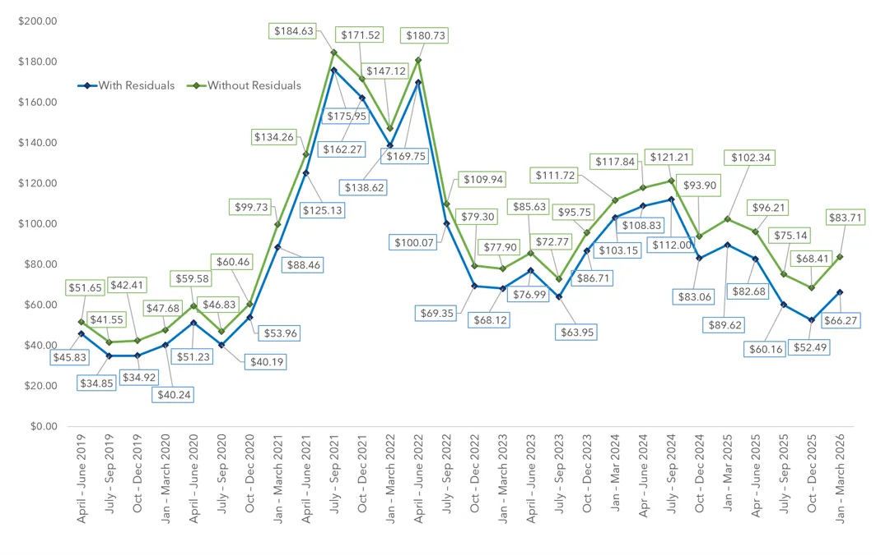
NERC MRF Average Bale Price Per Ton
Q2 2019 – Q1 2026
Notes:
BLUE LINE WITH COST OF RESIDUE DISPOSAL
$66.27 PER TON
GREEN LINE WITHOUT COST OF RESIDUE DISPOSAL
$83.71 PER TON
HIGHER PAPER, PLASTIC & METAL PRICES PUSHED AVERAGE UP

Slide 33
Where Is the Economy Going?
”Hard” data is a mix
GDP up 1.5%
Consumer price index up 0.1% mom & “core” 2.5%
Job growth down slightly
Unemployment down 0.1% to 4.1%
Real final sales to domestic purchasers up
Housing new permits up, starts down
Notes:
“HARD” DATA MEASURABLE IN DOLLARS OR WEIGHT, ETC, & ARE “LAGGING” B/C DATA REFLECTS THE PAST
DATA SOURCES INCLUDE:
GDP: https://www.bea.gov/data/gdp/gross-domestic-product
INFLATION: CORE PCI https://www.bls.gov/cpi/
MOST SINCE JUNE 2022
JOBS: https://www.bls.gov/news.release/jolts.nr0.htm
FEWER PEOPLE QUITTING JOBS, LESS HIRING, WHITE COLLAR LAYOFFS
REAL DISPOSABLE PERSONAL INCOME: https://fred.stlouisfed.org/series/dspic96
REAL FINAL SALES TO DOMESTIC PURCHASERS: https://fred.stlouisfed.org/series/A713RX1Q020SBEA
NOTE: JOB GAINS PRIMARILY IN HEALTHCARE & SOCIAL ASSISTANCE
HOUSING PERMITS & STARTS: https://www.census.gov/construction/nrc/current/index.html
HOUSING CONSTRUCTION SPENDING: DOWN YOY: https://www.census.gov/construction/c30/current/index.html

Slide 34
Where Is The Economy Going?
“Soft” data
Institute of Supply Management
Manufacturing up, still “growing”
New orders up, still “growing”
Production up, still “growing”
Employment up, “growing”
Prices down, still ”increasing”
Services flat, still “growing”
Logistics Managers Index:
Down
Cass Freight Index: down yoy & mom
Notes:
INSTITUTE OF SUPPLY MANAGEMENT (MAY)
MANUFACTURING PURCHASING MANAGERS INDEX
RESPONDENT COMMENTS CAUTIOUS BUT MORE POSITIVE THAN NEGATIVE
CONCERN OVER CONTINUATION OF IRAN WAR
SERVICES EXPANDING
LMI:
“DOWN FROM JUNE WHICH WAS FASTEST SINCE SPRING 22. STILL HIGHT THAN ANY READINGS FROM 2023-2025. THE SLOWDOWN IN EXPANSION STEMS SLOWER GROWT IN INVENTORY LEVELS.”
CASS (JUNE): OVERALL SHIPMENTS HAVE BEEN DECLINING SINCE THE summer of 2022

Slide 35
Where Is the Economy Going?
”Soft” data
Consumer sentiment/confidence
Michigan: dodwn
Conference Board: “edged down” for fourth month
CEO’s “tumbled” Q2
NAHB Homebuilder confidence
Inched up
NFIB small business optimism index
Up – finally above 52-year average
Notes:
“SOFT” DATA IS SPECULATIVE & FORWARD-LOOKING
UMICH: DOWN
THE CONFERENCE BOARD EDGED DOWN
ABOVE 2021 LOW
CONCERNS ABOUT HIGHER PRICES
EXPECTATIONS TUMBLED
CEO CONFIDENCE “PARTIAL REBOUND FROM Q2 SHARP DROP”
NATIONAL ASSOCIATION OF HOMEBUILDERS CONFIDENCE
UP 1% TO 35
35% OF BUILDERS CUT PRICES
AVERAGE PRICE REDUCTION 6%, SALES INCENTIVES AT 63%
17TH STRAIGHT MONTH SALES INCENTIVES ABOVE 60
NATIONAL FEDERATION OF INDEPENDENT BUSINESSES OPTIMISM INDEX (JULY)
EXPECTATION UP EVEN AS INFLATOIN PRESSURE HIGH

Slide 36
K-Shaped Recovery
American Express Sales, Profit Rise
on Higher Card Member Spending
Wall Street Journal, July 23
Notes:
9 PERCENT INCREASE IN IN SPENDING, THE HIGHEST GROWTH RATE IN THREE YEARS

Slide 37
Notable Headline
Grocery volumes contract for
fifth consecutive month, report finds
Grocery Dive, July 20

Slide 38
Notable Headline
Sales Are So Low,
California Wineries Are Burning Their Vineyards
NY Times, August 2

Slide 39
Notable Quote
“The consumer is muted, but stable.
Every consumer is looking for value.”
Andre Schulten, P&G
Wall Street Journal, July 30
Notes:
U.S. ECONOMIC GROWTH SLOWED TO 1.5% IN SECOND QUARTER
JULY 30, WSJ

