Slide 1

OKRA
September Conference
Recycling Markets Presentation
Fiber (Paper)
David Pelz
Executive Vice President

Slide 2
Oklahoma Recycling
Presentation Agenda
Recycling Process
Primary Paper Recycling Grades
End Users / Customers
  Expectations / Quality Items / Concerns
New Developments / Industry Trends
Question & Answer

Slide 3
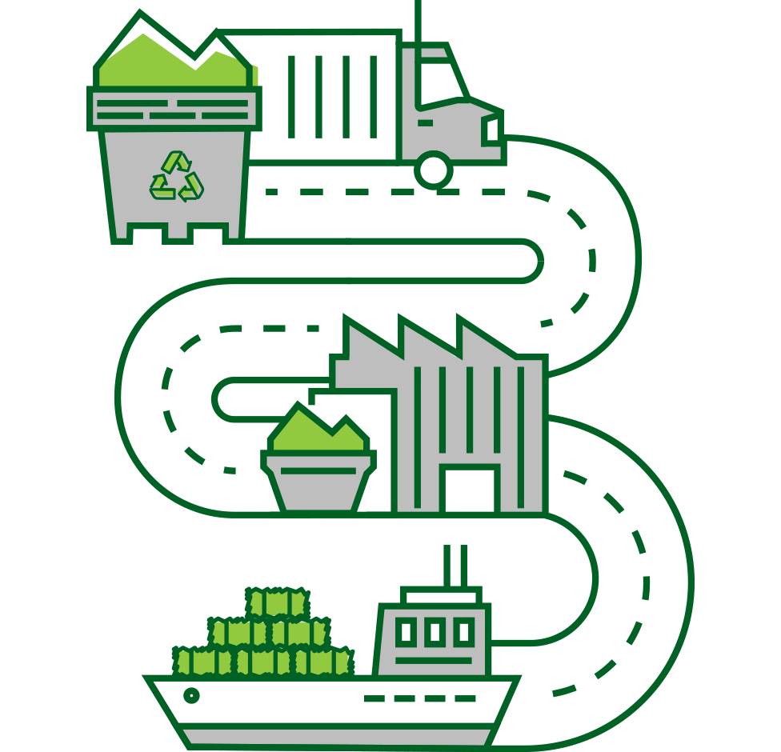
Paper Recycling Process

Slide 4
Recycling Statistics
Fiber
  More than 46 million tons of paper recycled in US in 2024
    Participation rate between 60 – 64%
  Greater than 33 million tons of OCC (US) recycled in 2024
    Collection rate of approx. 70%
  Globally, collection rate of OCC closer to 90%
  Residential Recycling
    Participation rate less than 35%
    Challenges include amount of trash in stream as well as infrastructure challenges

Slide 5
THE KRAFT PROCESS CLASSIFICATION DIAGRAM
BROWN STOCK
Brown
Kraft
Process
Tan
DLK
Grade #13
Kraft Bag Stock
Grade #19
Boxboard
Grade #4
Brown Kraft Envelope
Grade #21
Old Corrugated
Grade #11
Multi-Wall Bag
Grade #20
Carrier Kraft (Beer)
Grade #17
Used Brown Kraft
Grade #15
BLEACH PROCESS
GROUNDWOOD
Uncoated
Coated
Unprinted
Newsblank Grade 24
Unprinted
Publication Blanks
Grade # 26
Printed Section/
Newspaper
Printed
Sections
Grade # 44
News
Grade 6
Special News/
De-ink
Grade # 8
Overissue
News
Grade # 9
GWD CPO
Grade # 25
Trim – Clean
Flyleaf
Grade # 27
Trim – Glue
Hot Melt Shavings
Grade # 23-S
DELIGNIFICATION PROCESS
WHITE STOCK
Uncoated
“Bond” “Freesheet”
Coated
Unprinted
Unprinted
Hardwhite
Shavings
Cup Stock/
Plate Stock
Hardwhite
Envelope
Computer
Printout
Softwhites
Grade # 28
Solid Bleached Board
SBS
Grade # 47
Printed
Ledger
Printed
Cup Plate
Colored
Envelope
Grade # 33
Printed
CPO
Printed
Printed
Manifold
White
Ledger
Grade # 41
Manifold
Colored
Ledger
Grade # 39
Laser Free
CPO
Laser
CPO
Coated Book
Grade # 43
Lightly
Printed
Cup/Plate
Grade # 48
Medium
Printed
Cup/Plate
Grade # 49
Heavily
Printed
Cup/Plate
Grade # 51
Medium Printed Bleach
Grade # 46
Post Consumer
White Ledger
Grade # 40
Post Consumer
Colored Ledger
Grade # 38
Lightly Printed
Bleach
Heavily Printed Bleach
Grade #45

Slide 6
Recycling Commodities
Primary Paper Grades
CBS – Coated Book Stock
  Grade #43 as identified per Pulp and Paper Index
  Free sheet grade of paper
SOP – Sorted Office Paper
  Grade #37 as identified per Pulp and Paper Index
  Free sheet grade of paper
SWL – Sorted White Ledger
  Grade # 40 as identified per Pulp and Paper Index
  Free sheet grade of paper
Newspaper
  Grade #56 - SRPN
  Grade #58 – SCN
Mixed Paper
  Grade # 54 as identified per Pulp and Paper Index
  Combination of multiple paper grades
OCC – Old Corrugated Containers
  Grade #11 as identified per Pulp and Paper Index
  Cardboard

Slide 7
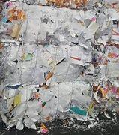
Coated Book Stock – CBS
Sorted Office Paper - SOP

Slide 8
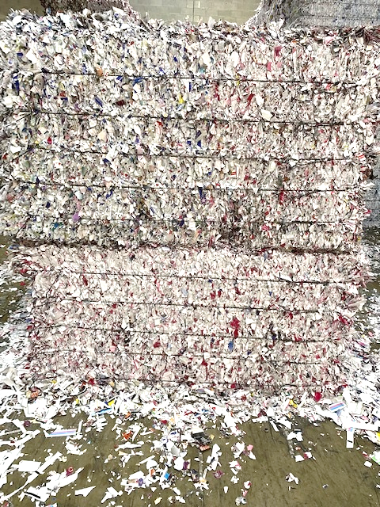
Coated Book Stock (Grade #43)
Sorted Office Paper (Grade #37)
Consists of office free paper, printed or unprinted in sheets, shavings,
Shredded paper / Office files
Primarily generated from office buildings / offices / print facilities
Coated book (free sheet) generally used in higher quality catalogs, etc.
Mainly used by end users that produce new tissue and toweling and/or writing paper

Slide 9
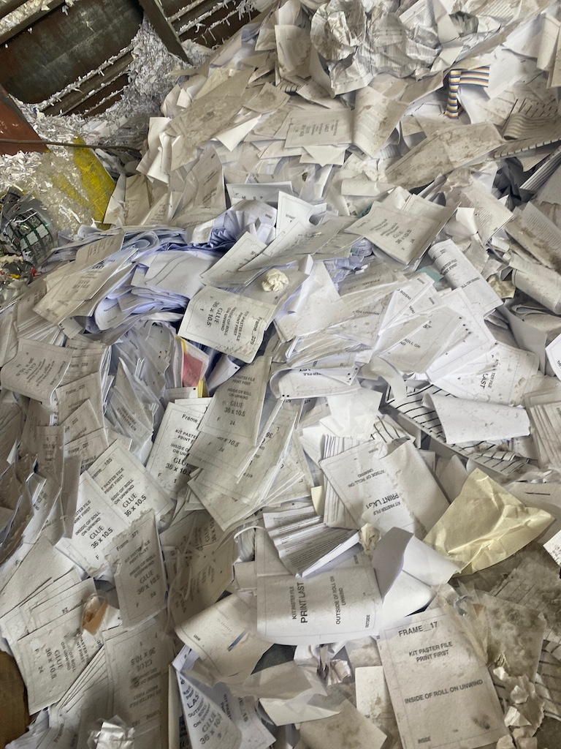
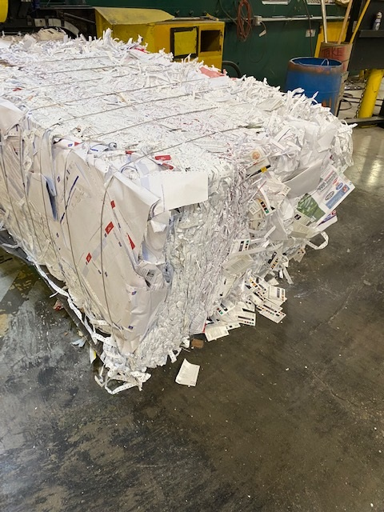
Sorted White Ledger - SWL

Slide 10
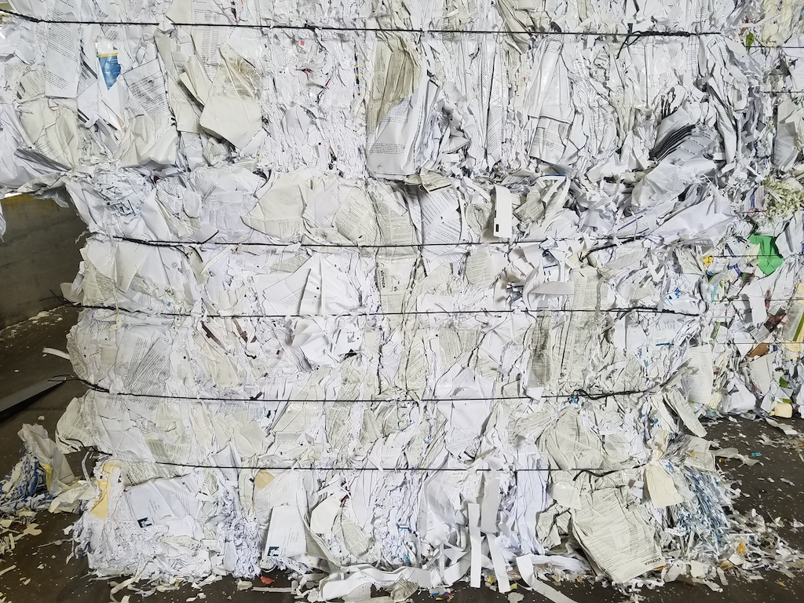
Sorted White Ledger - SWL
Uncoated, printed or unprinted sheets, and cuttings of white groundwood-free ledger, bond, writing and other paper
Differs from coated book as this commodity is all white papers
Higher grade of paper as compared to SOP
End users process SWL for the following:
  White Top / Tissue / New Reams
End users expect this pack to be free of contaminants

Slide 11
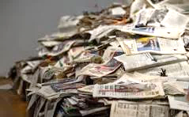
News Paper
Printed or unprinted ground wood newspapers
Continued decrease in generation of clean news paper with digital age
Material has evolved over time with introduction of single stream
  Material produced from single stream process
  SRPN (Sorted Residential Paper News)
  Higher grade of news paper
  Sorted Clean News (SCN)

Slide 12
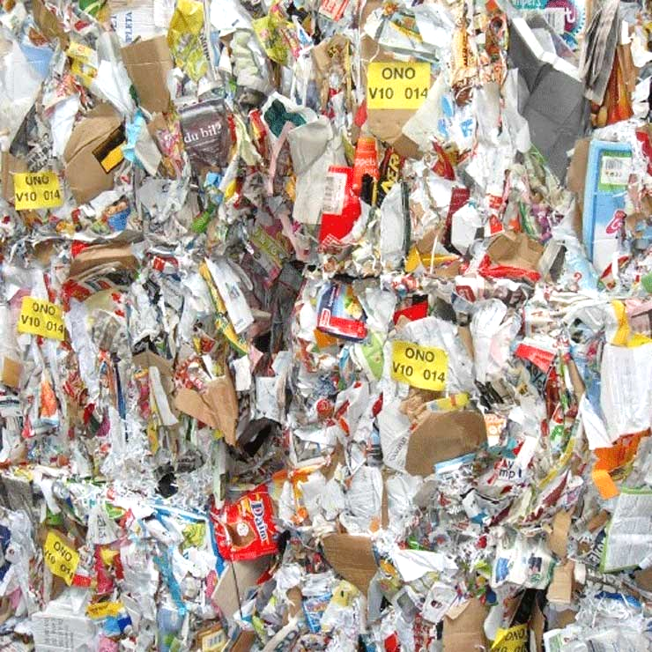
Mixed Paper
Mixture of paper commodities including boxes, kraft paper, newspaper, office paper, etc.
This is typically a negative sort on those facilities with automated sorting equipment to limit amount produced
Grade serves as catch all for many paper grades
Sources include residential and mixed recycling programs

Slide 13
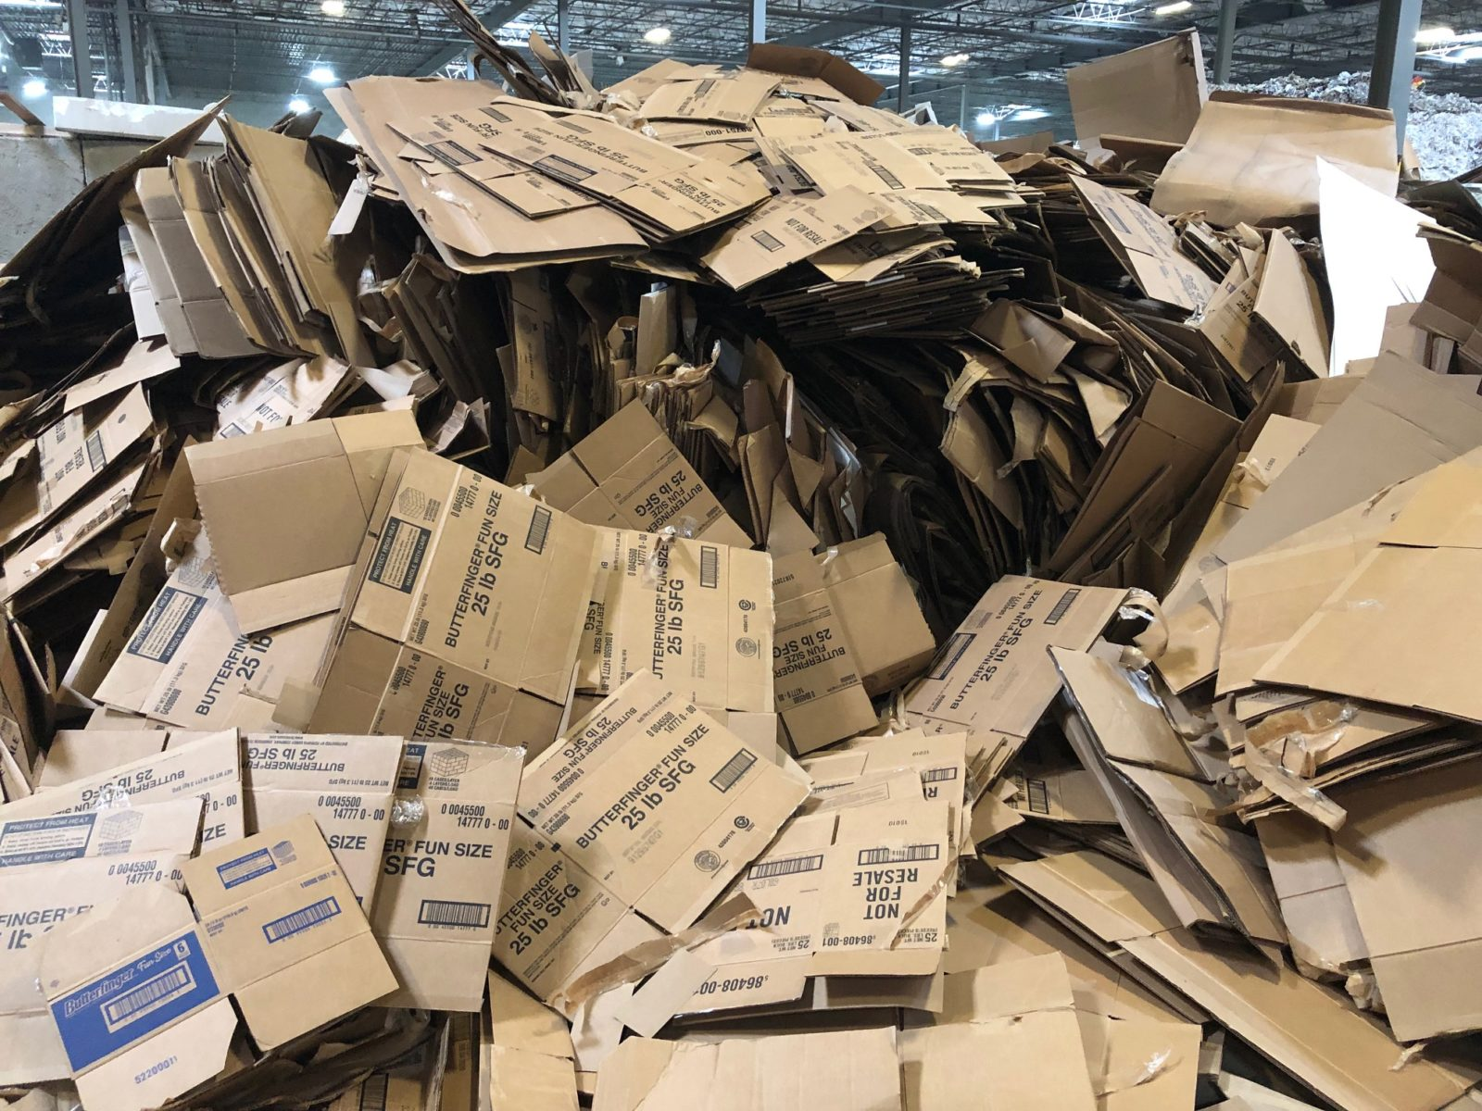
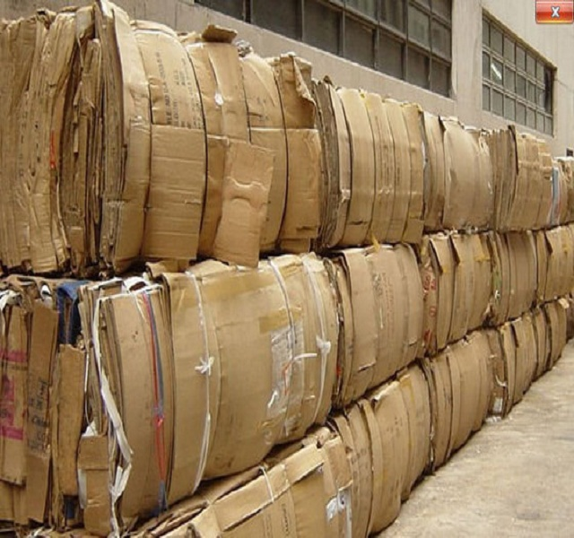
Old Corrugated Containers

Slide 14
Old Corrugated Containers (OCC)
Post use corrugated packaging material
Easily recognizable by its multiple layer structure
  Fluted or wavy middle layer between sheets
Cardboard is a very useful packaging material for easy transportation of many different types of products
On average, a corrugated box contains roughly 50% recycled fiber. Around 52 % of OCC is used to make new corrugated
Cardboard can be recycled five to seven times
End users of OCC make new linerboard for new boxes

Slide 15
Who Produces OCC
Primary Sources:
  Commercial and Industrial
    Large warehouses
    Grocery Stores
    Corporate Retailers
    Distribution and Fulfillment Centers
    Manufacturing Plants
    Packaging Plants
  Residential
    Single Stream Program
    Multi Tenant

Slide 16
Customer / End User
Expectations of Received Material
Quality Issues
Marketplace and Uses

Slide 17
End User / Mill Expectations
Recycled material loaded in a “safe manner” and meets end users’ requirements
Achieving minimum weight thresholds for trailer loads / rail cars
Consistent bale integrity
  Properly tied bale
  Proper size for handling
Material meets quality per industry standards
Receiving proper paper grade

Slide 18
Fiber Quality
Most commodity specifications allow for a small % of outthrows – less than 1%
Contaminants vary by grade to some extent, but most grades consider the following to be Out throws:
  Garbage
  Food waste
  Styrofoam and plastic wrapping
  Certain poly and plastic coatings
  Beater dye – dark color print pages (certain instances)
  Tyvek and nylon/woven material
  Wood – broken pallets
Bale integrity
  The recycled pack is properly packaged (baled) for easy handling

Slide 19
Contamination
Examples
OCC
  Medical Waste
  Food Waste
    Blood Material
  Excessive wax content
  Yard Waste
  Lesser quality brown kraft items
  Plastics / Cafeteria Waste

Slide 20
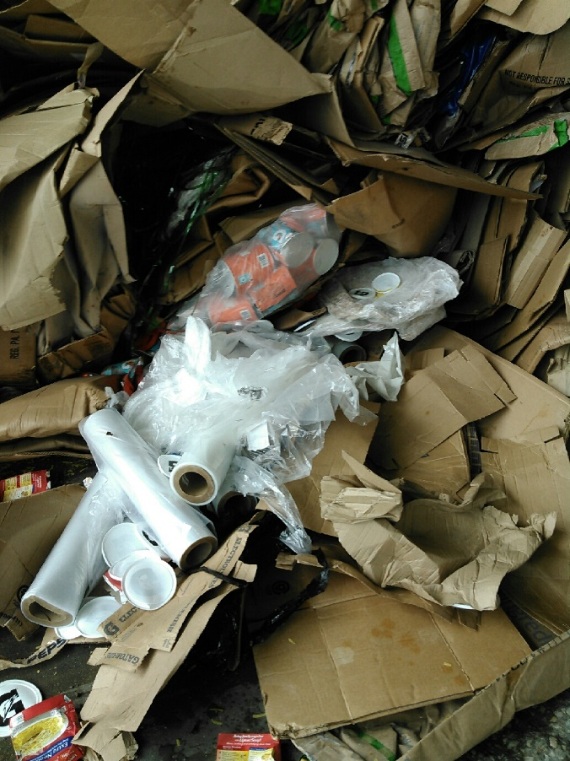
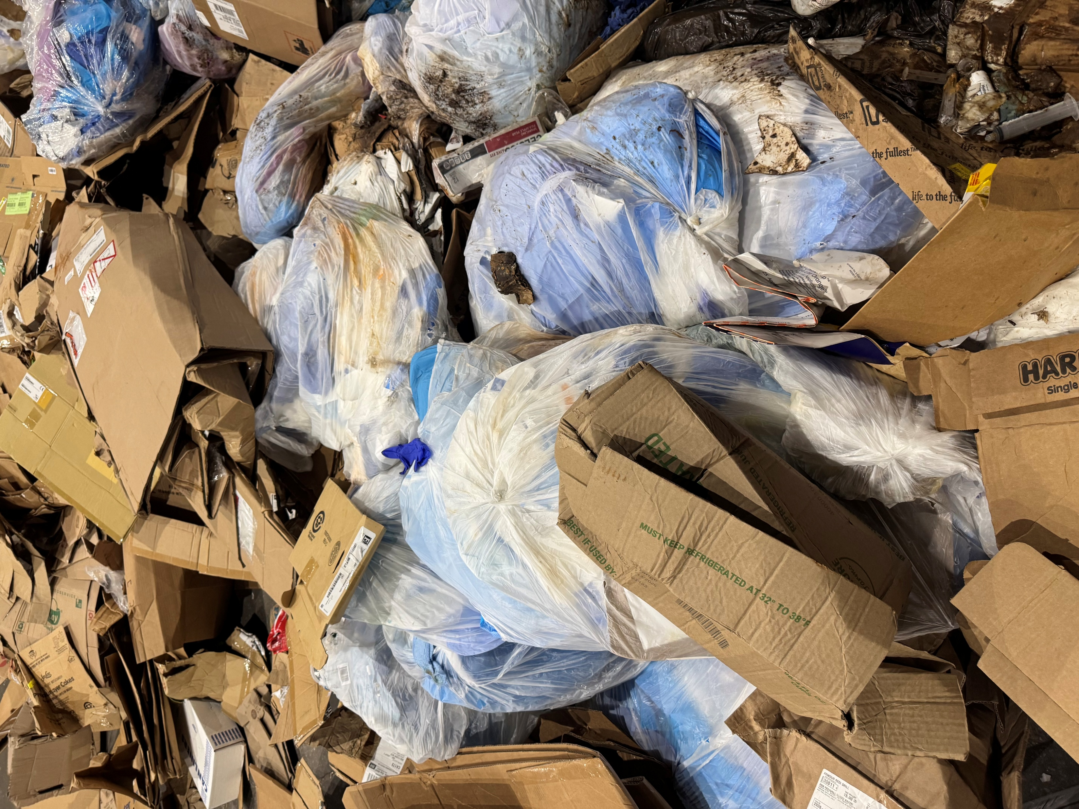
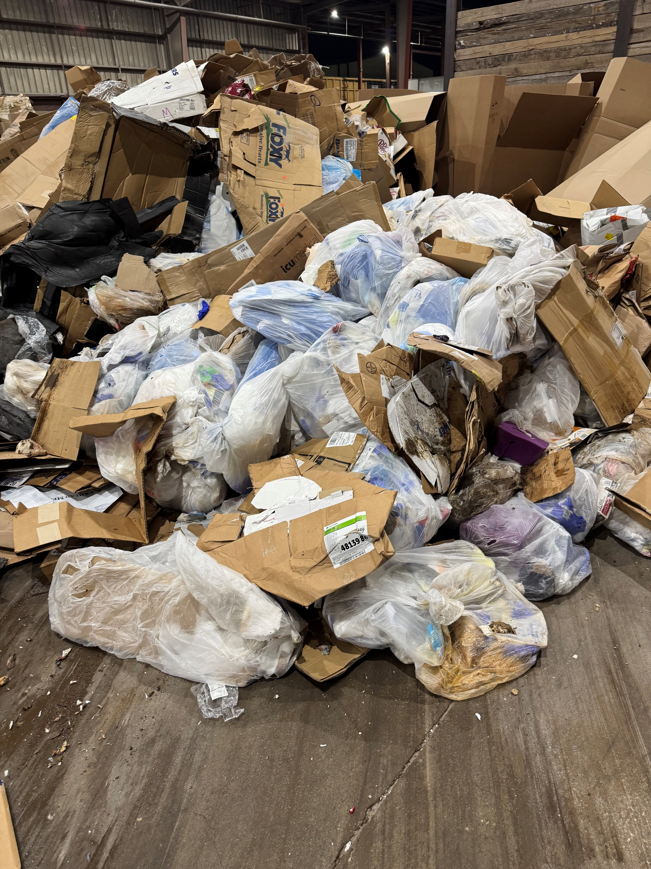
OCC
Contaminants

Slide 21
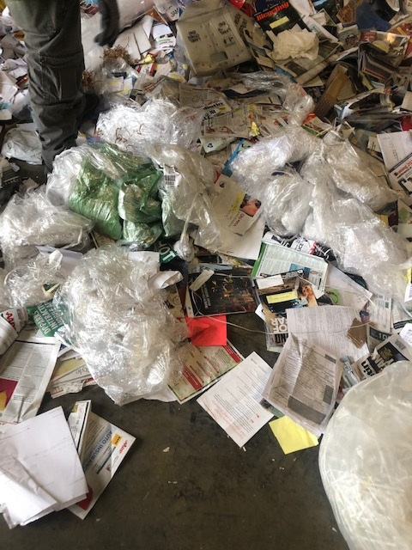
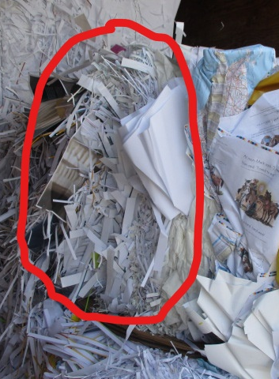
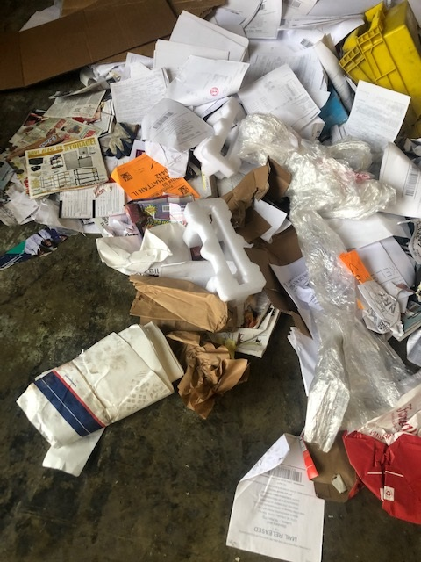
Contamination
Coated Book
Print material mixed with Styrofoam and plastic
Sheets of cardboard
Plastic coating
Lunch room waste

Slide 22
Customers
Market Place
New Products

Slide 23
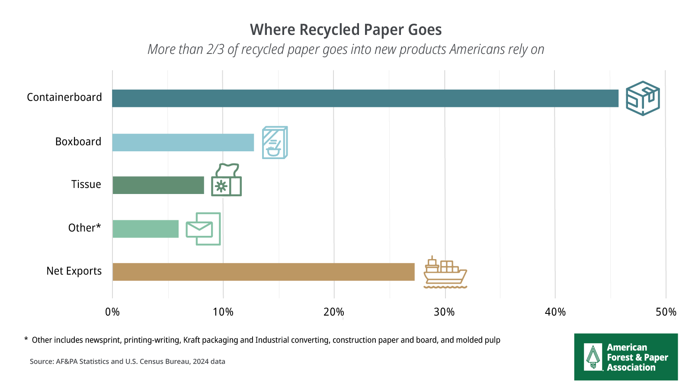

Slide 24
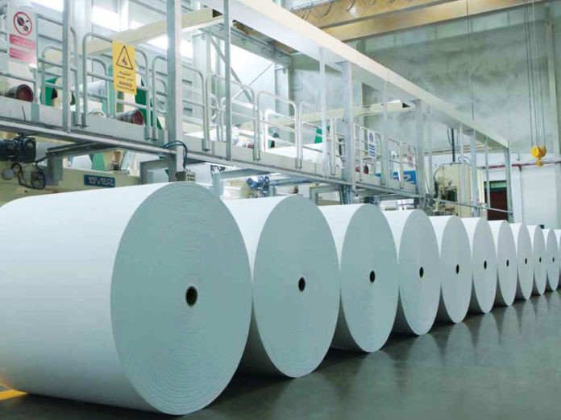
Customers / End Users
Tissue and Toweling Mills
Printing & Writing Paper Mills
Linerboard Mills
Super Calendar Mills
Light Weight Coated Mills
Newsprint Mills
Coated Duplex Board Mills
Recycled Pulp Producers
De-Ink Pulp Producers

Slide 25
Other / Alternate Markets
Ceiling Tile Manufacturers
Molded Pulp Products
Insulators
Others
  Tube & Core

Slide 26
OCC Video
https://youtu.be/yCPeElrhbIQ?si=CbyzMi9LmdZHJmNn

Slide 27
Industry Trends
Paper industry is shifting towards sustainable packaging with 100% Recycled material
Continued closure of newsprint mills
Fine writing paper mills
  Conversions to packaging
Consumers switch from retail to e-commerce
Continued decline in generation of print material
  Less paper print
  Conversion to digital

Slide 28
Industry Trends
Graphic Packaging – Waco, TX
  State of the art mill commissioned in 2025
  Produces coated recycle paperboard
Clearwater
  Launched new CRB product line in collaboration with Greenpaper (Mexico based)
  Expanding presence in Southwest US
PCM
  Installed new machines producing kraft line and medium
  Will increase consumption of recycled products (raw material)

Slide 29
Questions and Answers
Thank you

